Slide 1
Hamilton Jacobi Multi-Time Reachability
Manan Doshi¹, Manmeet Bhabra¹, Marius Wiggert², Claire J. Tomlin², Pierre F.J. Lermusiaux¹
¹Massachusetts Institute of Technology
²University of California, Berkeley
Notes:
Hello everyone,
I am Manan Doshi. Today I will be talking to you about HJ multitime reachability. This is joint work from collaborators in UC Berkeley and MIT

Slide 2
Outline
Motivation
Problem Statement
Background
Theory
Results
Notes:
I will first go into why we are looking at reachability in the first place. We will then formalize our problem statement and then talk about the current state of the art approach to solve it. I will then talk about our method and why it might be better than what we have out there. We will then go into the results where we have applied this theory to a bunch of test cases

Slide 3
Motivation
Reachability analysis refers to the computation of states of a system that can reach a target set in a given time.
Hamilton-Jacobi reachability analysis has successfully used for a variety of practical problems, including path planning for ocean vehicles, multiplayer reach-avoid games, aerial refueling, etc.,.
Current state-of-the-art methods are especially computationally expensive when the underlying dynamics is time varying, and in the presence of moving target and obstacle sets.
Notes:
Refer to Marius talk

Slide 4
Problem Statement
(Time varying) System dynamics:
State
Controls
Time
System trajectories
Position of a system at time ‘s’ under the initial condition ‘x’ at time ‘t’ under the controls given by ‘u(.)’

Slide 5
Problem Statement
Obstacles and Targets:
Time varying sets in the state space
Objective: Compute the backward reachability tube

Slide 6
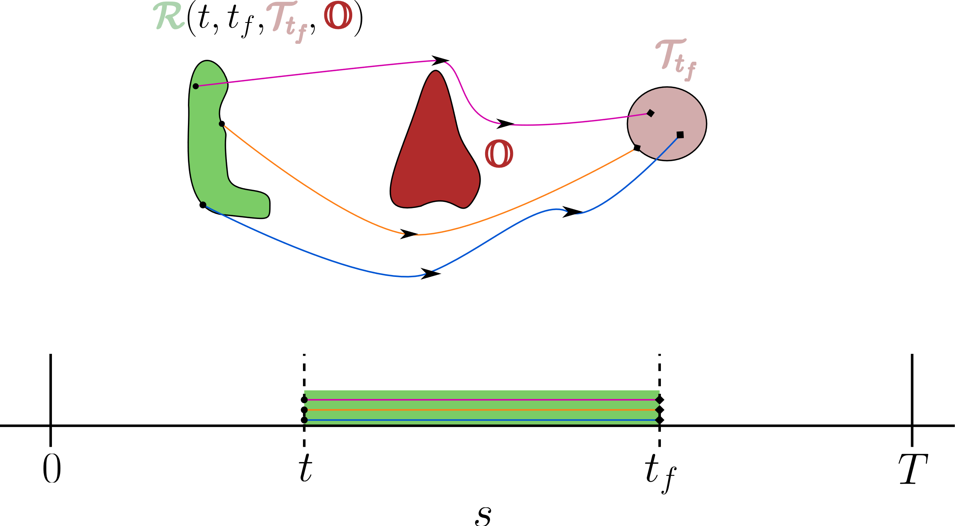
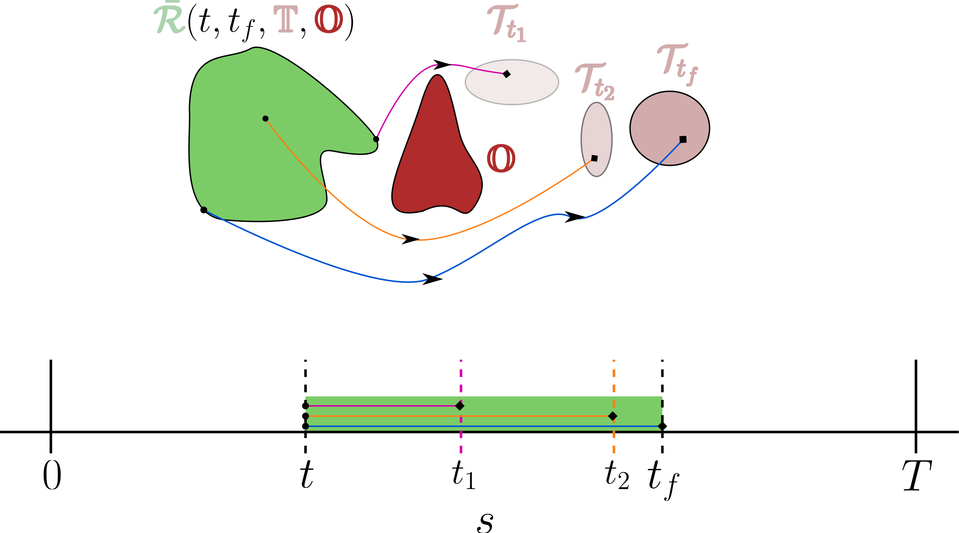
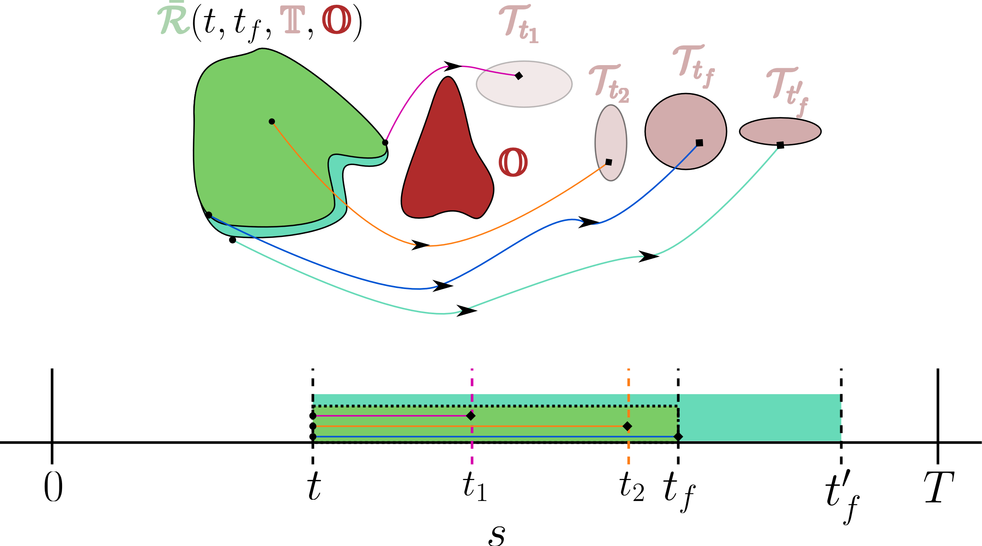
Problem Statement
Objective: Compute the backward reachability tube
BRS
BRT

Slide 7
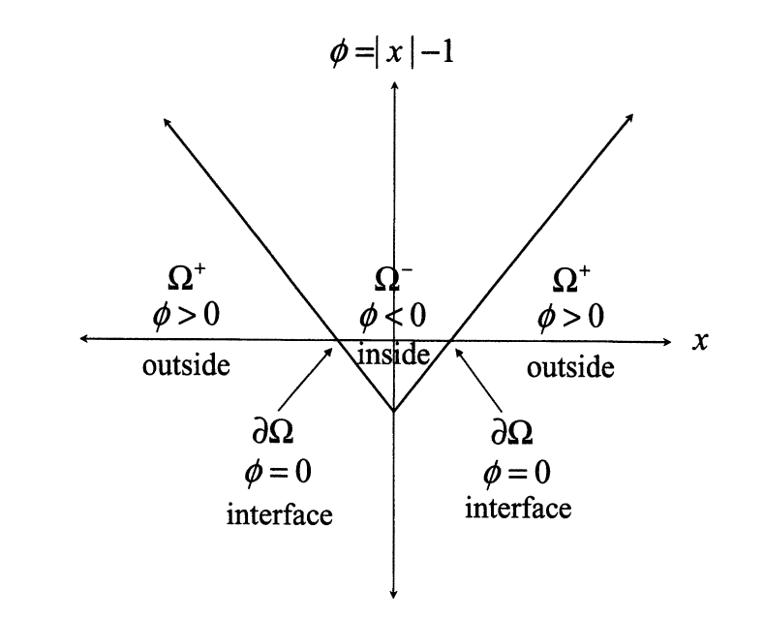
State of the art: HJ reachability analysis
Cast the problem: BRS computation -> optimal control problem.
Define:
Terminal cost function as the signed distance from the target set boundary.
Running cost to be equal to zero
Signed distance from destination set
= 0
The value function:
Minimum terminal distance from destination set
From Level Set Methods and Dynamic Implicit Surfaces by Osher et al.

Slide 8
State of the art: HJ reachability analysis
The backward reachability set can be computed from the value function:
Cannot reach the destination at time ‘t_{f}’
Can reach the destination at time ‘t_{f}’
Using dynamic programming, we can obtain this value function by computing the viscosity solution of the HJ PDE

Slide 9
State of the art: HJ reachability analysis
What can we improve? It would be nice to have a method that can …
Solve for all BRTs in a single PDE solve. Current approach requires us to perform a single PDE solve to compute all backward reachable sets for a fixed ‘t_{f}’.
Naturally handle of moving target and obstacle sets
Give us a closed loop policy obtained from the value function with some nice optimality properties
We propose a modification to the method that achieves all these objectives
Notes:
Schematic to elaborate why time varying matters. Not just a function of time horizon. Different start times, different reachable sets.
Point 3: refer to marius talk

Slide 10
Theory: Multi-time reachability
Augmented dynamics
Stay in the obstacle
Stay in the target
Follow original dynamics
Augmented cost function
Infinite cost if we end up in the obstacle
When in the target
Distance from the target.
0 inside the target
Notes:
Make sure intuition comes across. Start with high level approach.
Start with why this is better to motivate.

Slide 11
Theory: Multi-time reachability
Total cost
Value function: Cost under optimal control

Slide 12
Theory: Multi-time reachability
Value function
If you can reach the target while avoiding obstacles,
Linear function of the minimum time to reach
If you cannot avoid the obstacle
If you cannot reach the target and can avoid the obstacle
Notes:
- Nice for failure modes. E.g. in ppt 1

Slide 13
Theory: Multi-time reachability
Hamilton-Jacobi PDE
Notes:
Arbitrary times
Field of level sets
Secondary quantities
Optimal controller

Slide 14
Theory: Multi-time reachability
Backward Reachable Tube
Closed loop optimal control law
Time to reach maps
Notes:
Arbitrary times
Field of level sets
Secondary quantities
Optimal controller
- Small animation. Vizualization

Slide 15
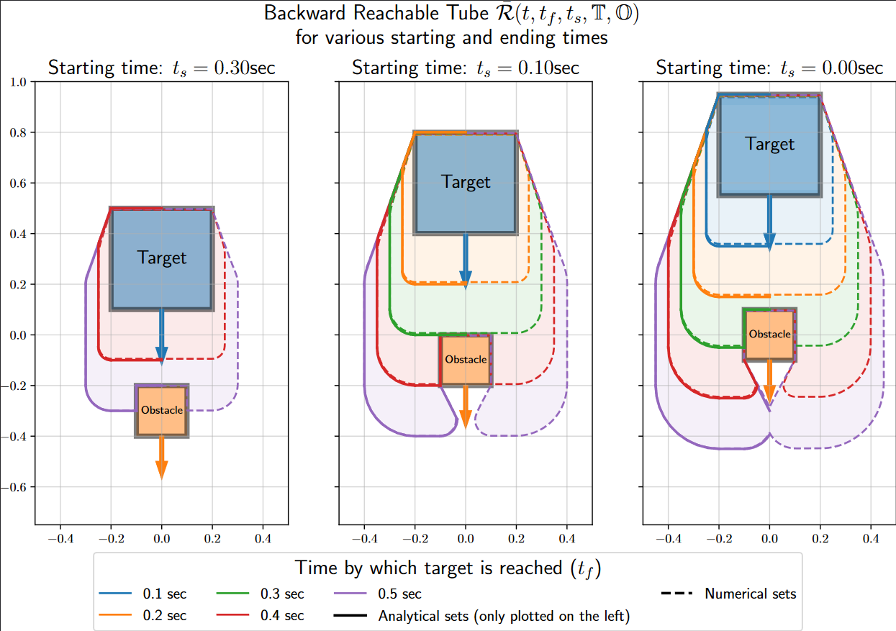
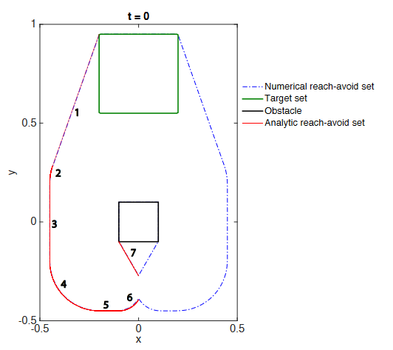
Results: Case 1
System dynamics
J. F. Fisac, et al., “Reach-avoid problems with time-varying dynamics, targets and constraints,” in conference on hybrid systems: computation and control, 2015

Slide 16
Results: Case 2
System dynamics: Dubin’s car
Case setup:

Slide 17
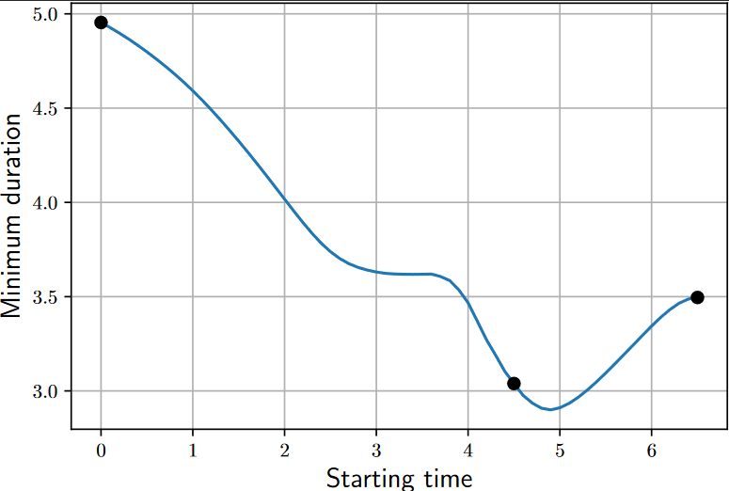
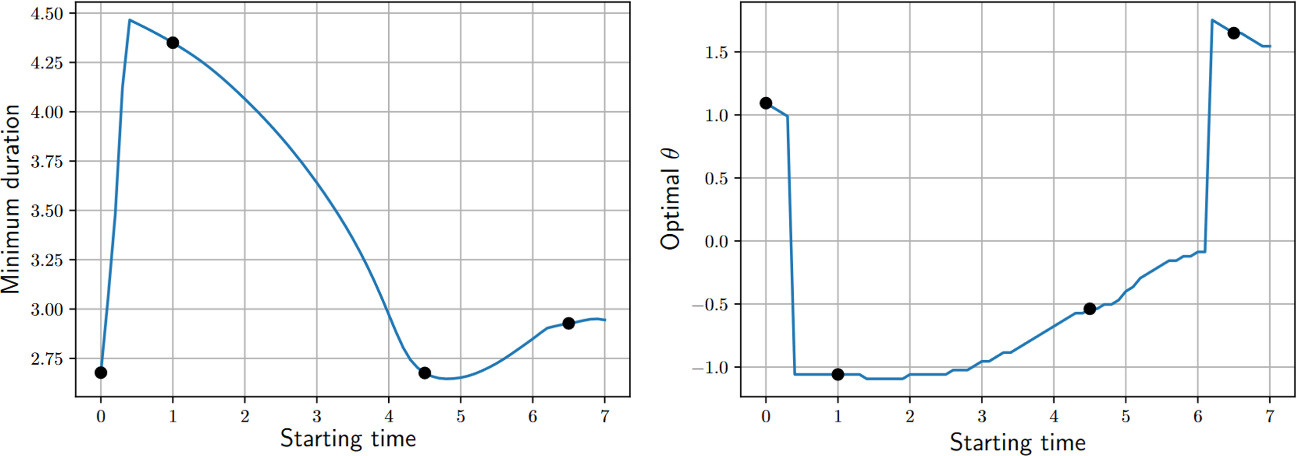
Results: Case 2
Minimum duration as a function of starting time
Fixed starting angle
Unconstrained starting angle. Choose optimal starting angle

Slide 18
Results: Case 2
Verification: Optimal paths for the various starting points, angles and times

Slide 19
Results: Case 3
System dynamics

Slide 20
Conclusion and Future work
Made significant computational improvements in a powerful technique without any tradeoffs*
Given a time varying continuous dynamical system, with moving targets/obstacles/start points, we can compute a time optimal controller, backward/forward reachability tubes and duration maps using a single PDE solve
A natural extension of this work would be multi-reachability in two player games.
*Another ongoing effort is to understand the effect of high gradients of the value function on the accuracy of the numerical solver.
Notes:
Simplify wall of text. Use icons.

Slide 21
Thank You!

Slide 22
Extra slides

Slide 23
Numerics
For the reachability PDEs, high-order methods on structured, uniform meshes have been used.
Care must be taken in numerically solving the PDEs. What are known as Monotone Schemes have to be used to solve these equations which fall in the family of Hamilton-Jacobi PDEs.
Have used popular variants of the Lax-Friedrichs scheme (i.e. Local Lax-Friedrichs Scheme, Global Lax-Friedrichs Scheme, etc.) to numerically compute the solution of the reachability PDE.
The Backtracking ODEs can be solved using standard explicit or implicit schemes.
Initial implementation in MATLAB – built on top of Ian Mitchell’s Level set toolbox.
Current implementation in JAX – built on top of ‘hj_reachability’ by Ed Schmerling. Faster because of just in time compilation and parallel capabilities and allows auto-differentiation

Slide 24
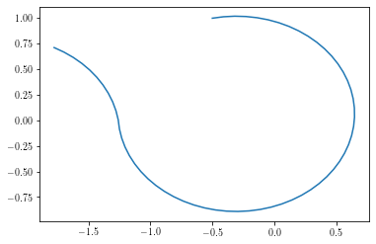
Boundary weirdness is a legit trajectory!

Slide 25
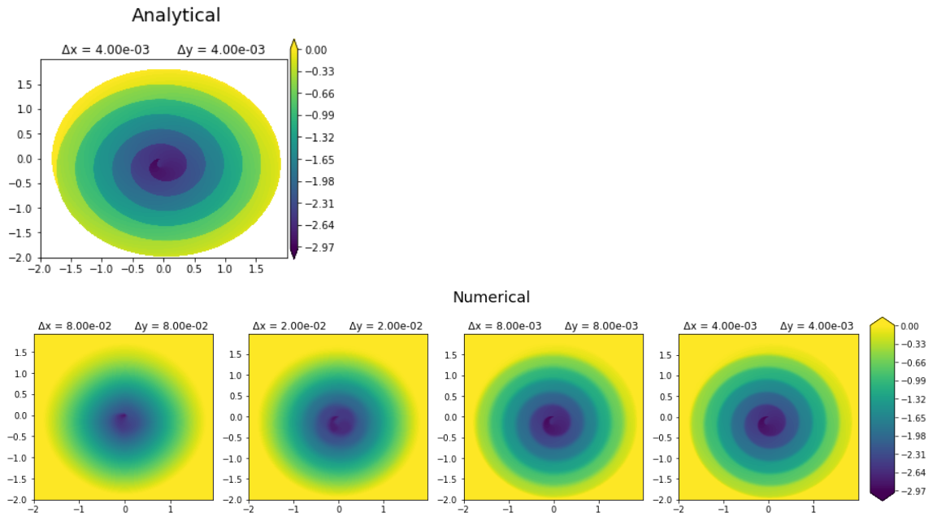
Sharpness numerics

Slide 26
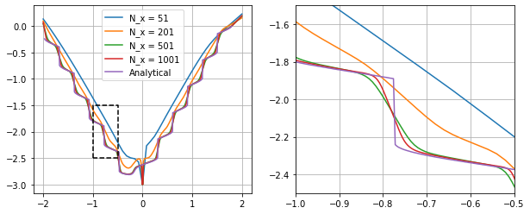
Sharpness numerics

