Slide 1




PDEs and Characteristics Governing Dynamical Systems:
Optimal-Harvesting Path Planning and
Lagrangian Analysis of Inertial Particles
Manan Doshi
Advisor: Prof. Pierre Lermusiaux

Slide 2
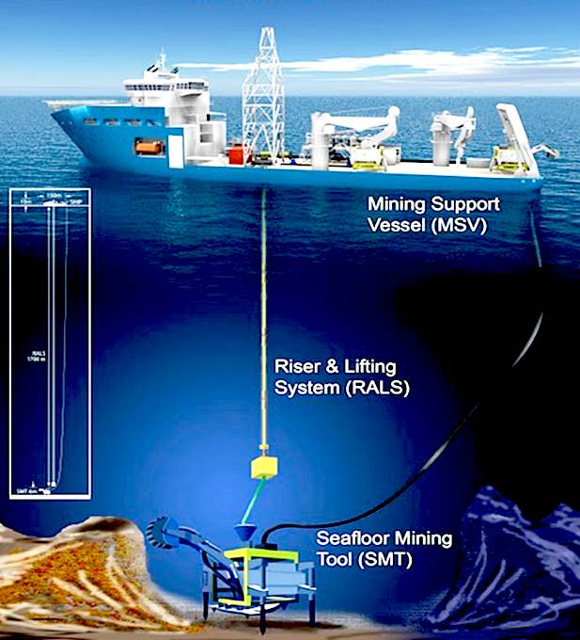
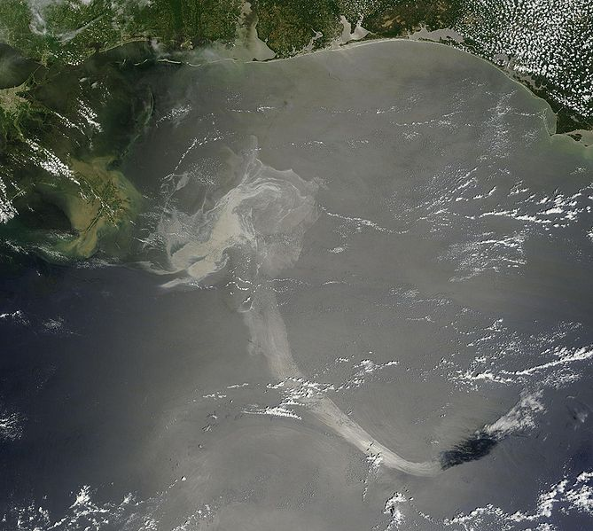
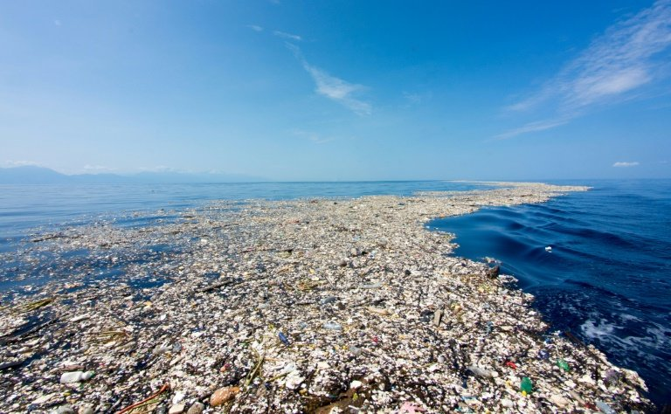
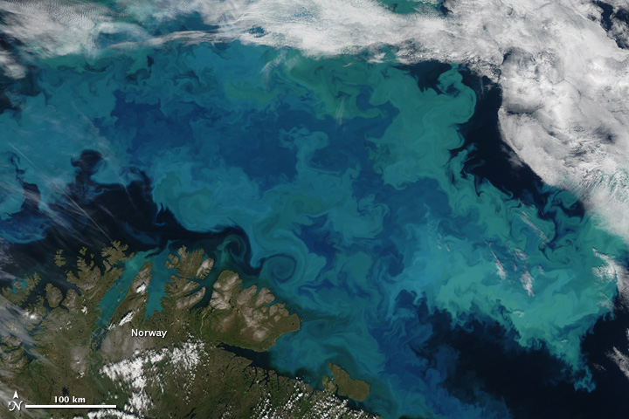
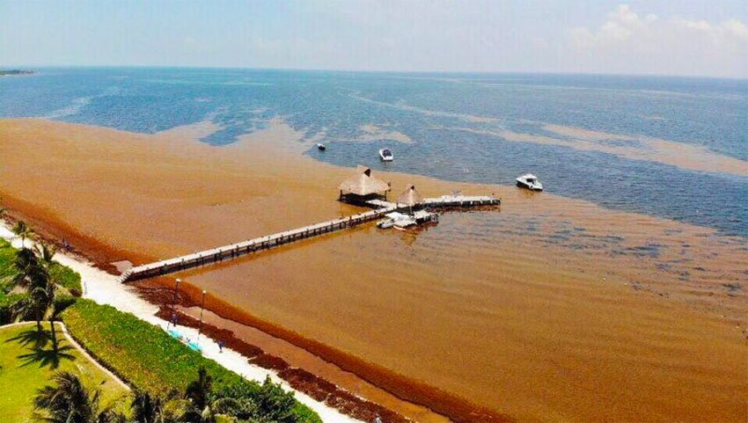
Background and Motivation
Predicting the transport of inertial and dynamically active particles in the ocean is essential for the health of our planet.
Examples include:
Marcel Petroleum Exploration
Peacock et al., Physics Today ‘13
The Ocean Cleanup
Marine Plastic Pollution
Oil spills
Deep sea mining plumes
NASA Earth Observatory
Mexico News Daily
Plankton and biomass transport
Sargassum Invasion
Notes:
These are complex phenomenon that we’d like to be able to predict so as to understand their ecological impacts on the ocean

Slide 3
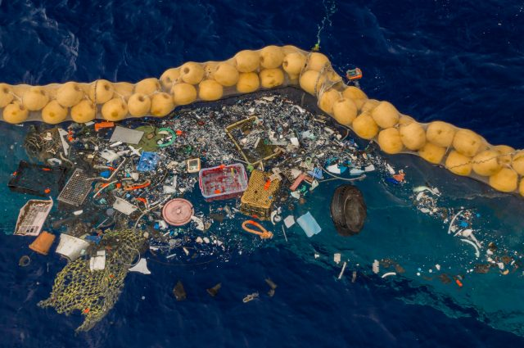
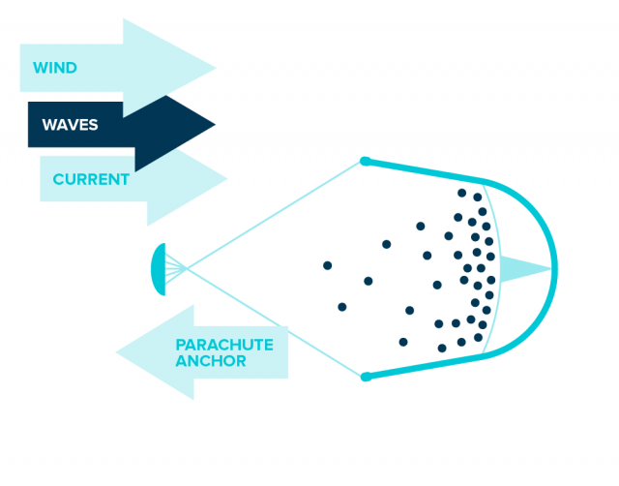
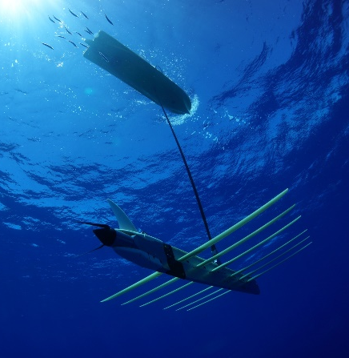
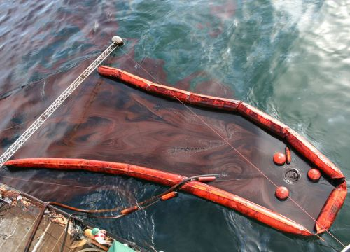
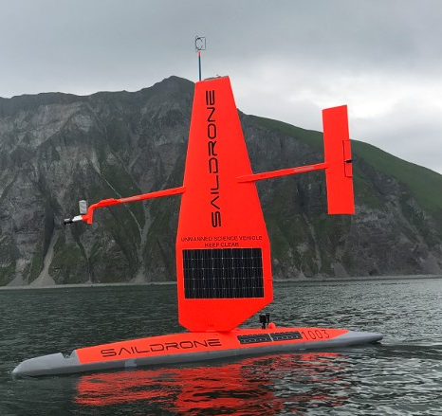
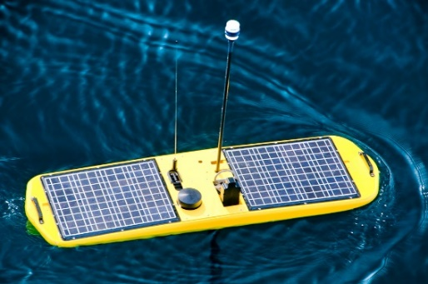
Background and Motivation
The optimal collection and monitoring of active materials is also essential for the efficient protection and sustainable utilization of the ocean.
The Ocean Cleanup
The Ocean Cleanup
Liquid Robotics
NOAA
Examples of problems we aim to solve:
Time-optimal collection of a field of marine material
Time-optimal path planning for dynamically-constrained vehicles that can collect energy from their surroundings
Saildrone
Liquid Robotics
3

Slide 4
Underlying Idea
State augmentation to create a higher-dimensional PDE
whose characteristics are the governing equations of our dynamical system.
Existing methods
Derived methods
Time-optimal path planning in dynamical flows
Time-optimal path planning in dynamical flows with dynamic collection constraints
Predicting transport of passive particles using flow maps
Predicting transport of inertial/dynamically active particles using flow maps
Recall: method of characteristics
4
Notes:
- Better graphic for characteristic

Slide 5
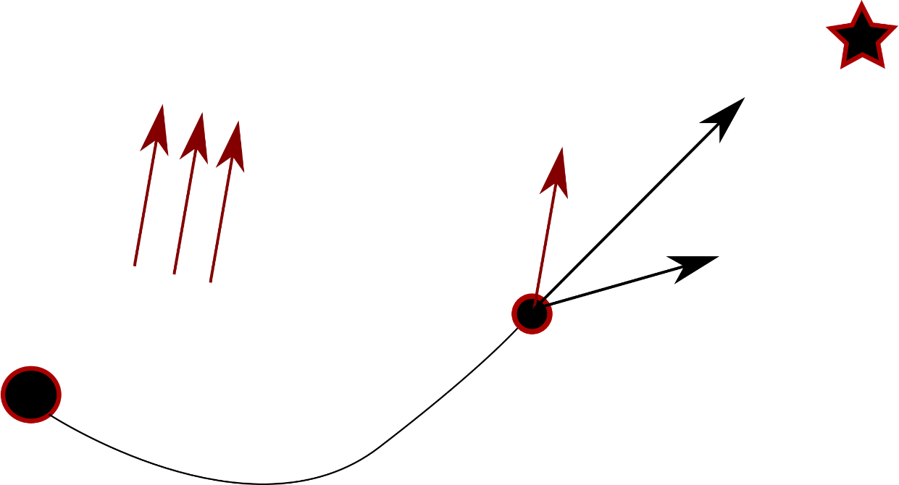
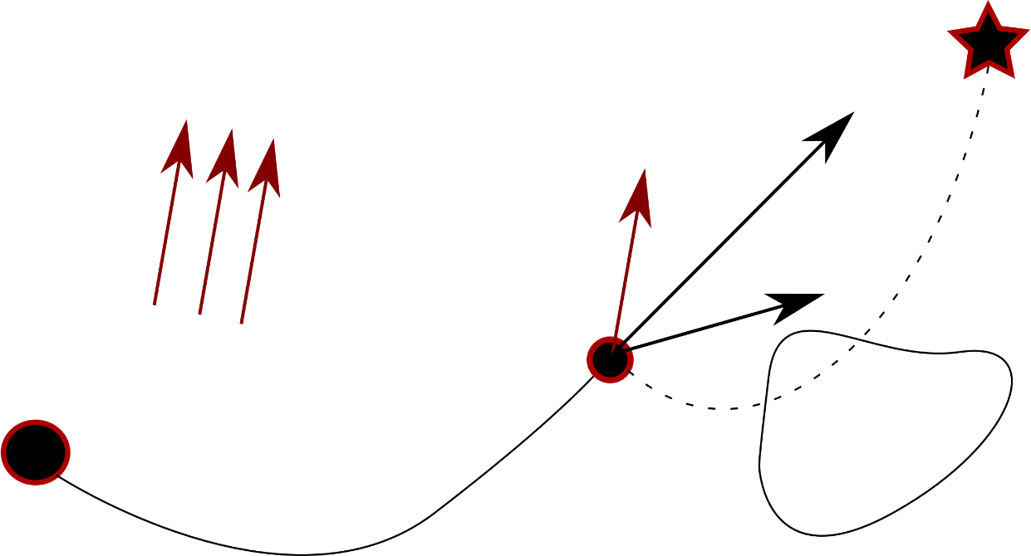
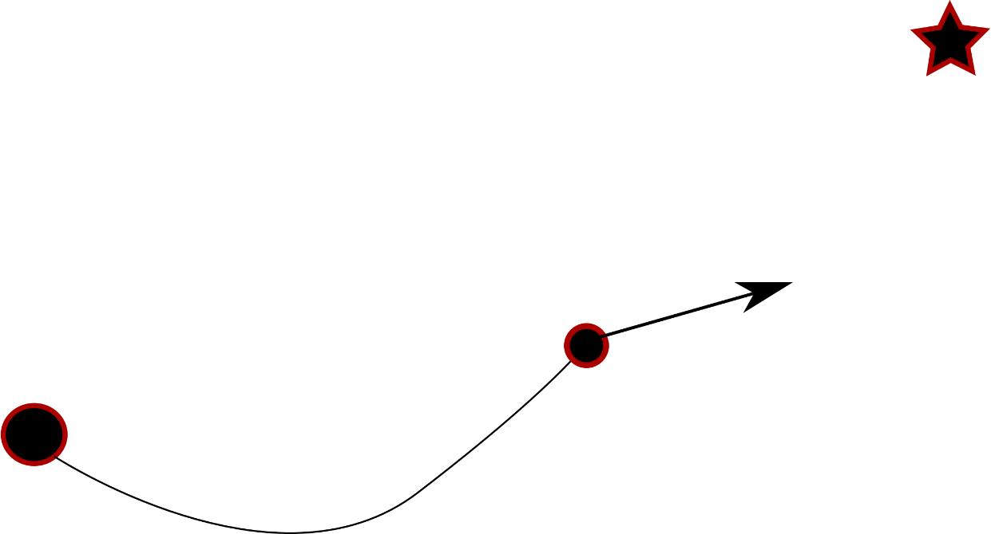

Optimal-Harvesting Path Planning
Goal: Find the quickest path for a vehicle:
From start point to destination
In a flow in which the vehicle is being advected
Which is dynamic
While collecting a required amount of background field
Which is also dynamic!
We build upon methods for time-optimal path planning
  Based on:
  Rapidly exploring random trees¹
  A* search²
  Artificial potential methods³
State of the art
Issues:
sub-optimal, heuristic dependent, for static fields
We base our method on the algorithm developed for time-optimal path planning using the Level Set method⁴.
5
¹ Kuffner, ICRA ’01; ² Garau, ICRA ’05; ³ Warren, AUV ’90; ⁴ Lolla et al., ICRA ’12; Lolla et al. Ocean Dynamics ’14
Notes:
TODO: Rearrange or whitespace: CK

Slide 6

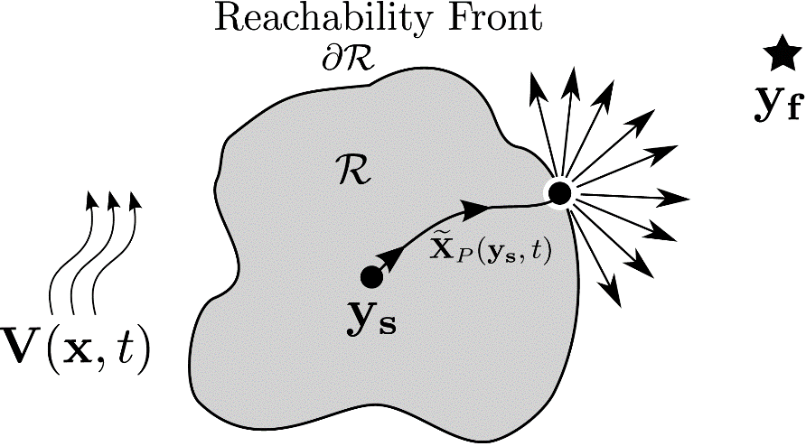
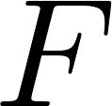
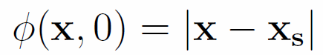

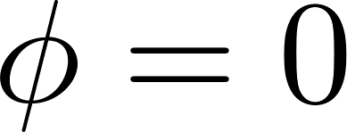
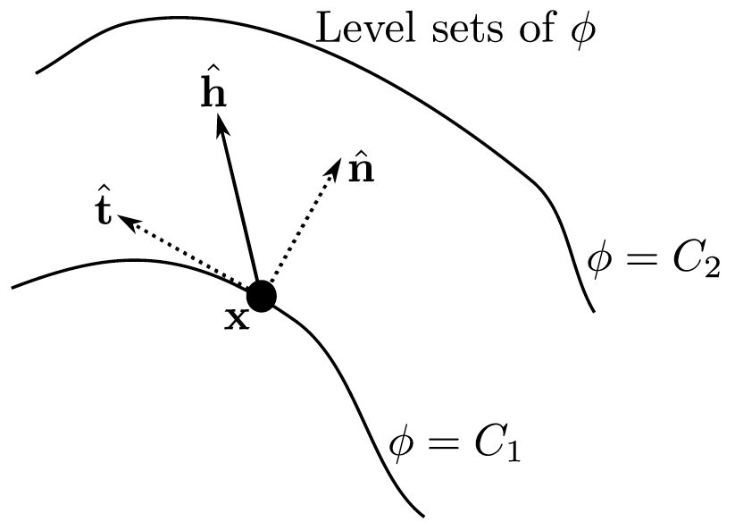
Exact, Time-Optimal Path Planning with Level Sets
  Reachability front
  Contour containing the set of positions that can be reached at a given time
  Implicitly represented as the zero level set of a signed distance function
  Lagrangian viewpoint
  Eulerian viewpoint
  End
  Start:
  Start
  End:
  How to evolve the reachability front?
  Backtrack optimal trajectory once destination is reached
6
Lolla et al., ICRA ’12; Lolla et al. Ocean Dynamics ’14; Lolla & Lermusiaux SICON ’17; Lermusiaux et al., HOE ’13
Notes:
TODO: Arrangement

Slide 7
Optimal-Harvesting Path Planning
How do we integrate field collection into our framework?
Background flow
Start
Max vehicle speed
Destination
Vehicle heading
Vehicle dynamics
Harvesting dynamics
Attract level set to locations with high values of field
Heuristic, sub-optimal, parameter-dependent, may not provide a solution.
Energy-optimal path planning:
  Tracks energy for the ‘vehicles’ of interest on the reachability front; then stop vehicles that run out of energy
  Incorrect; possible to collect more by staying inside the front.
  Can be solved using stochastic optimization¹ when no energy is
  harvested ( )
  Expensive, relies on reduced order representations of F(t), not generalizable.
7
1: Subramani, Deepak N., and Pierre FJ Lermusiaux, Ocean Modelling 100 (2016): 57-77.

Slide 8
Optimal-Harvesting Path Planning
Solution: State-space augmentation to obtain a higher-dimensional Hamilton-Jacobi equation
Characteristics include collection dynamics and vehicle dynamics
8
Notes:
Needs some illustrations. Break into 2 slides. Make big D into small d

Slide 9
Special Case 1: Optimal-Collection Path Planning
Hamilton-Jacobi equation for reachability front evolution
Maximization
TVD - RK4
5th-order WENO
Godunov Method
9

Slide 10
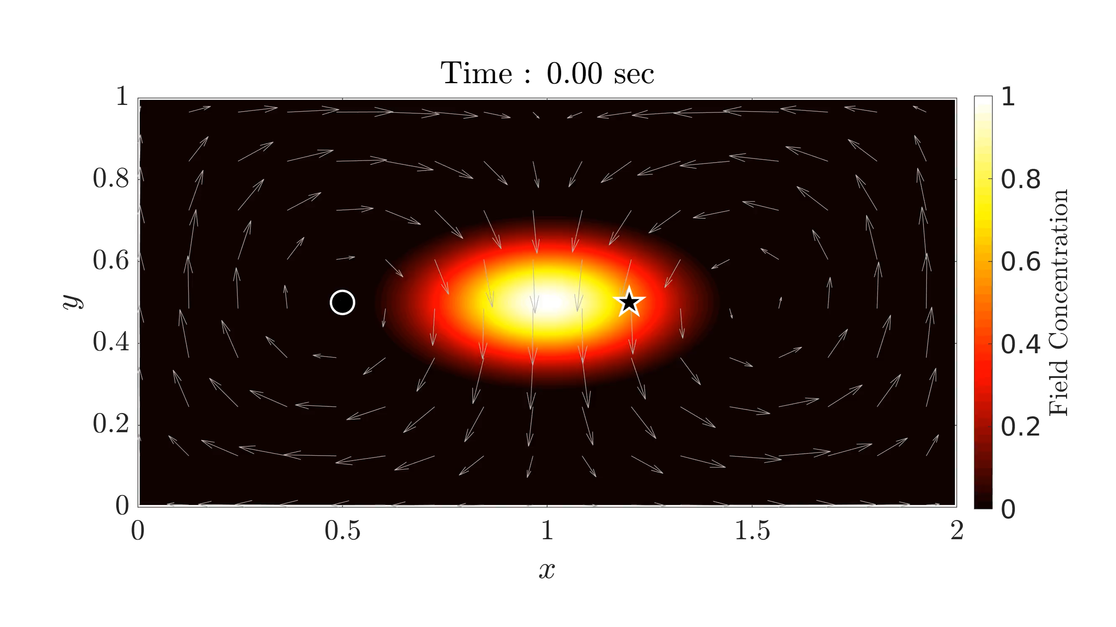
Example 1: Optimal-Collection Path Planning
Start point
Final point
Collection constraint: 0.8
Max Speed: 0.4
10

Slide 11
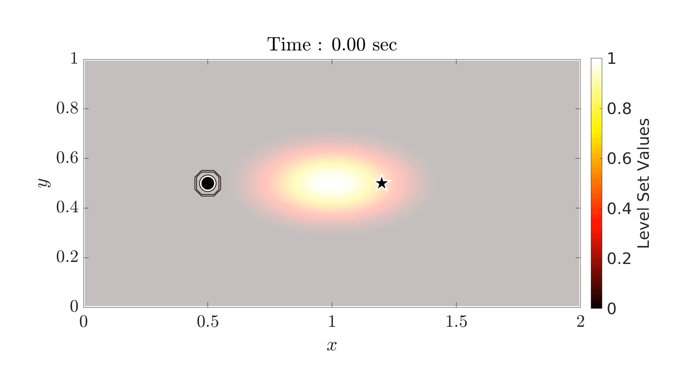
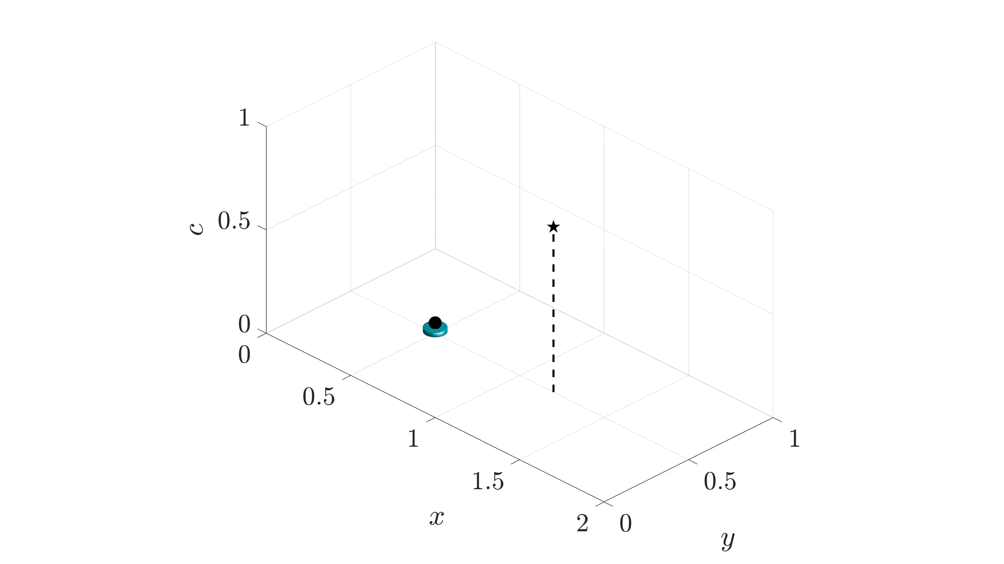
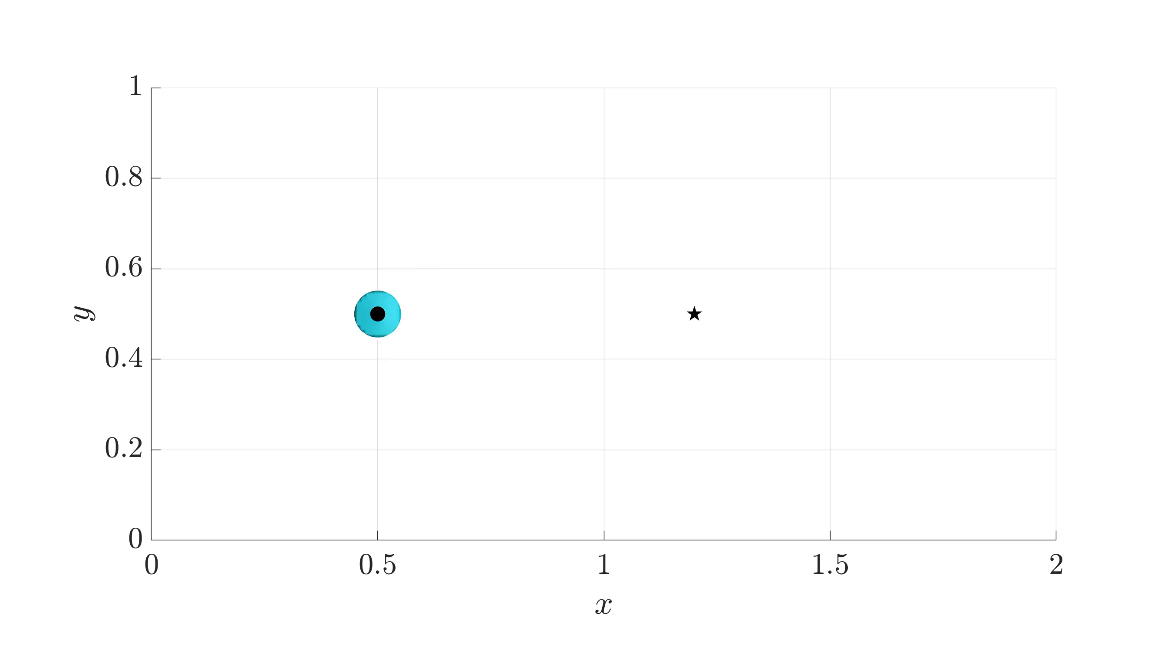
Example 1: Optimal-Collection Path Planning
Start point
Final point
Collection constraint: 0.8
Max Speed: 0.4
Notes:
TODO: 2 videos

Slide 12
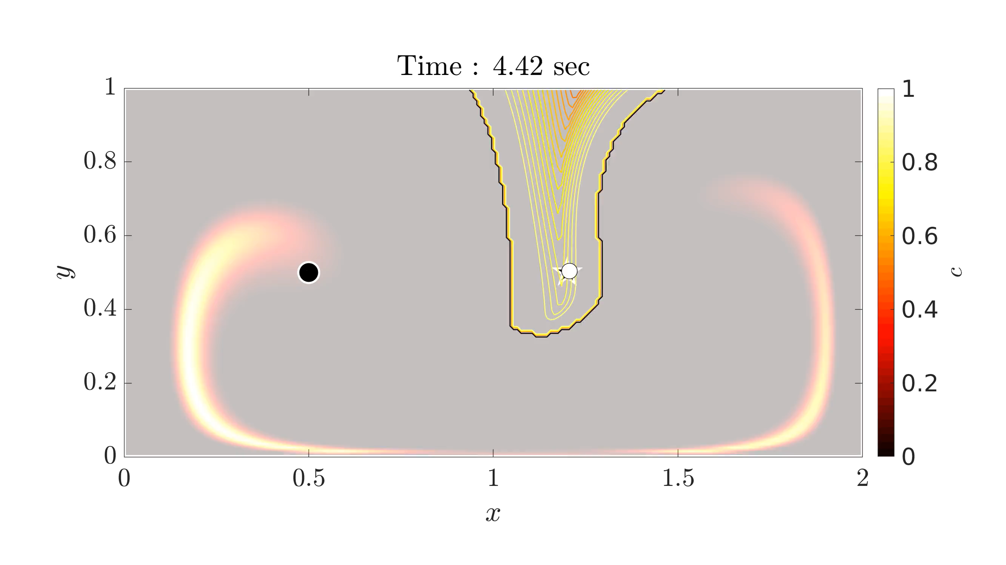
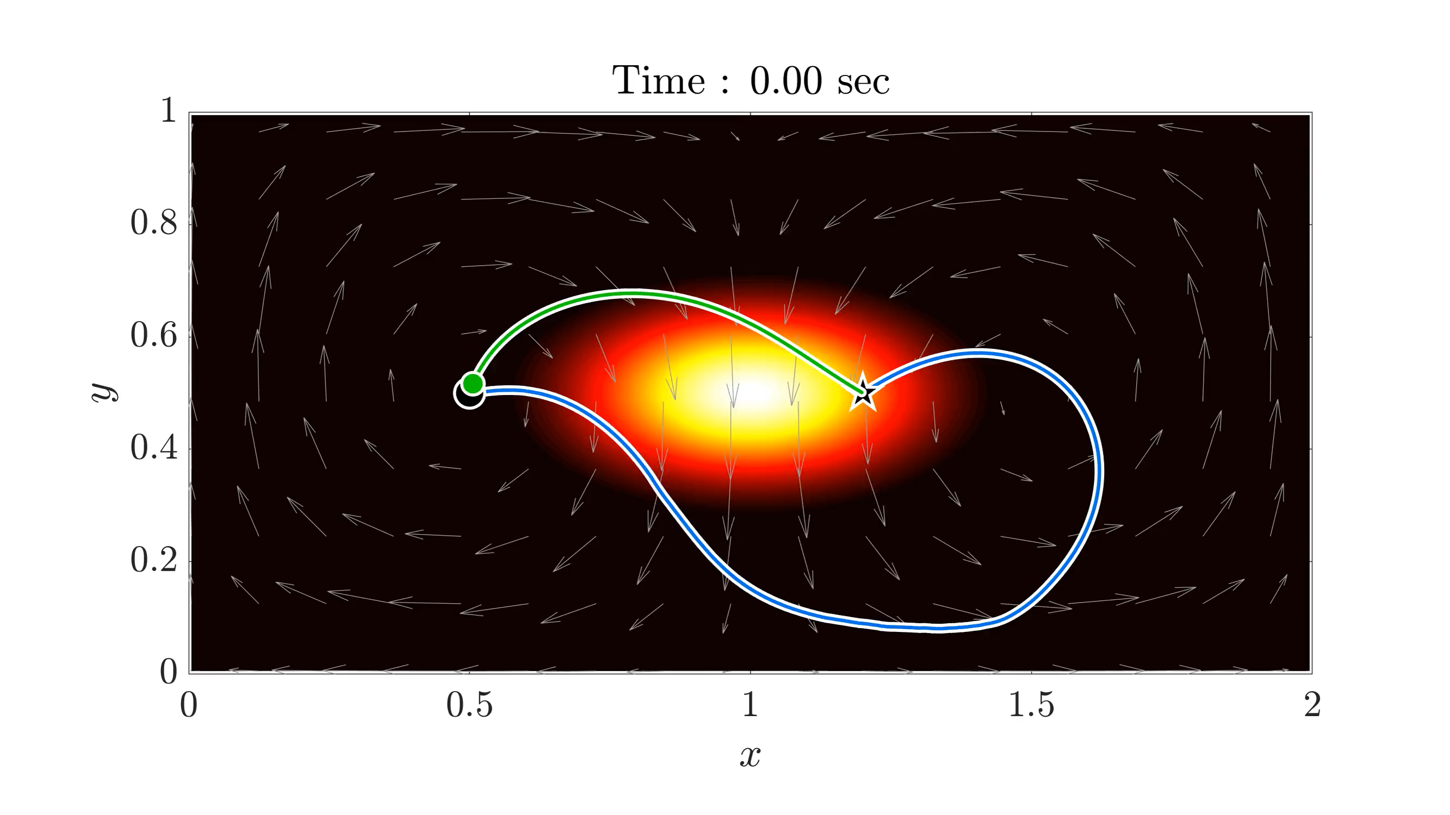
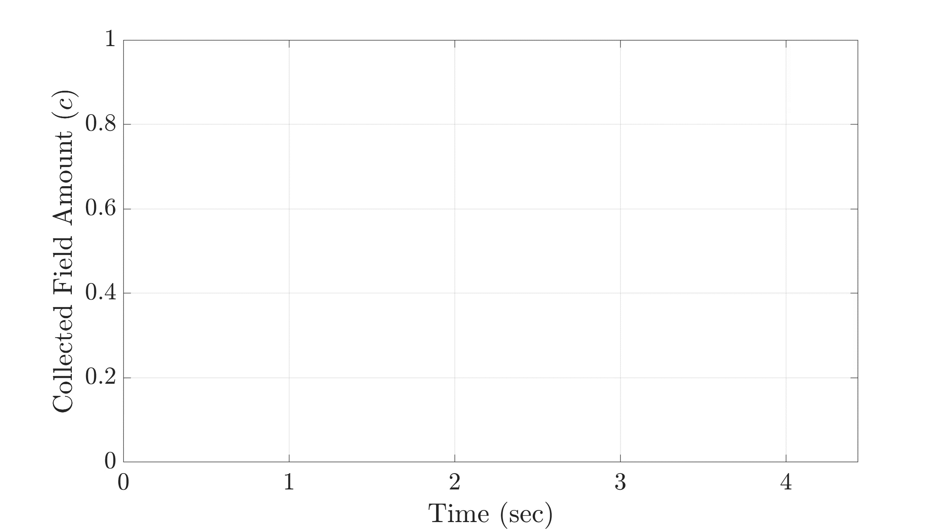
Example 1: Optimal-Collection Path Planning
Backtrack to obtain the optimal path
Solution features:
Velocity field used to reach destination quickly
Vehicle collected requisite amount of field
Time Optimal Path
Collection Constrained Path
12
Notes:
`

Slide 13
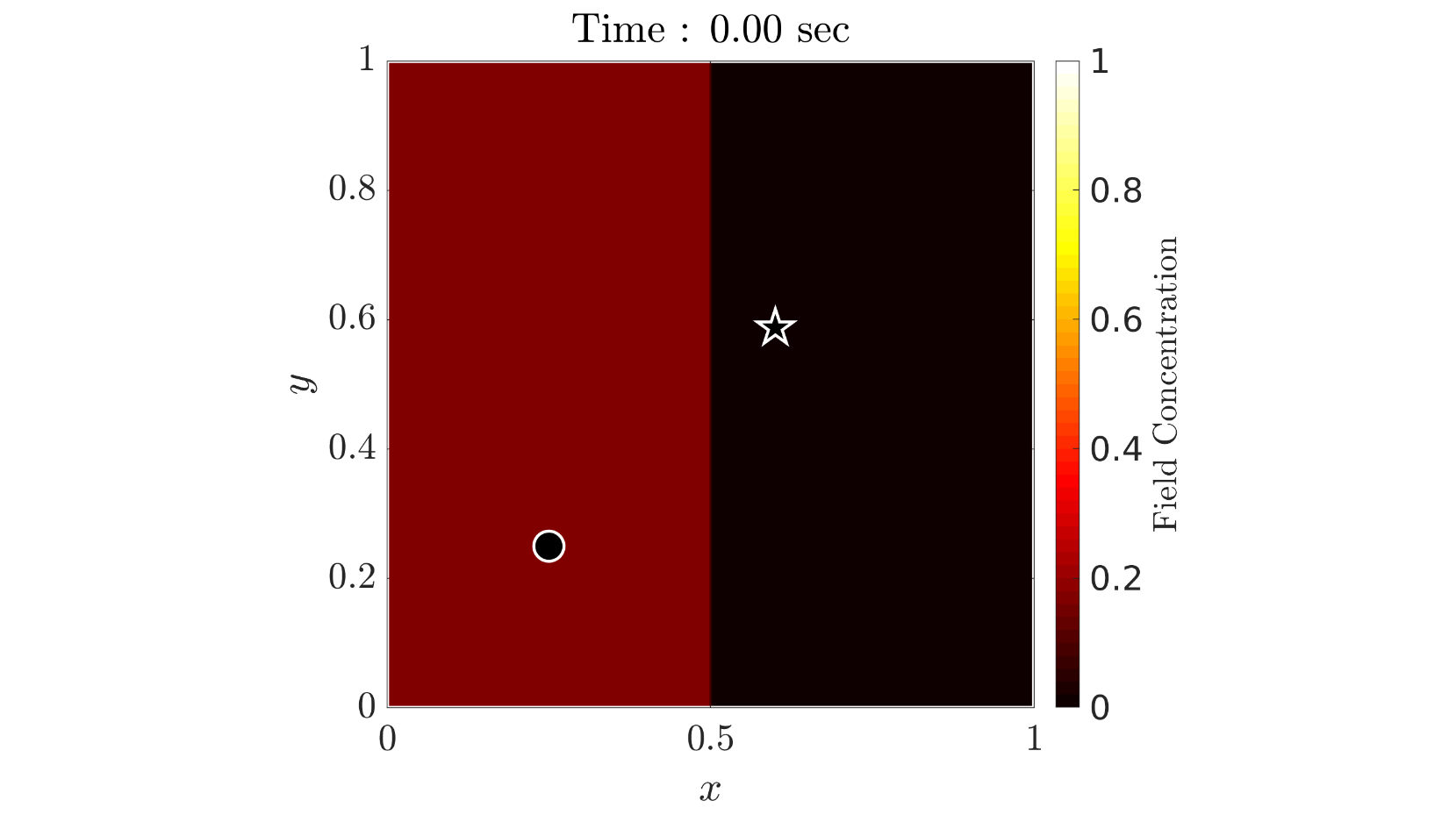
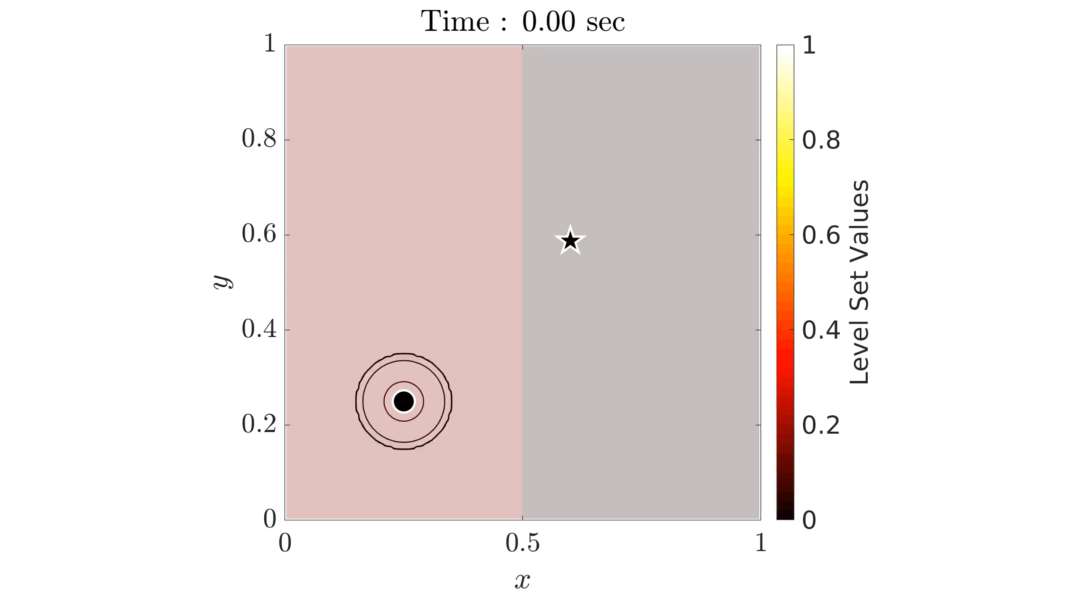
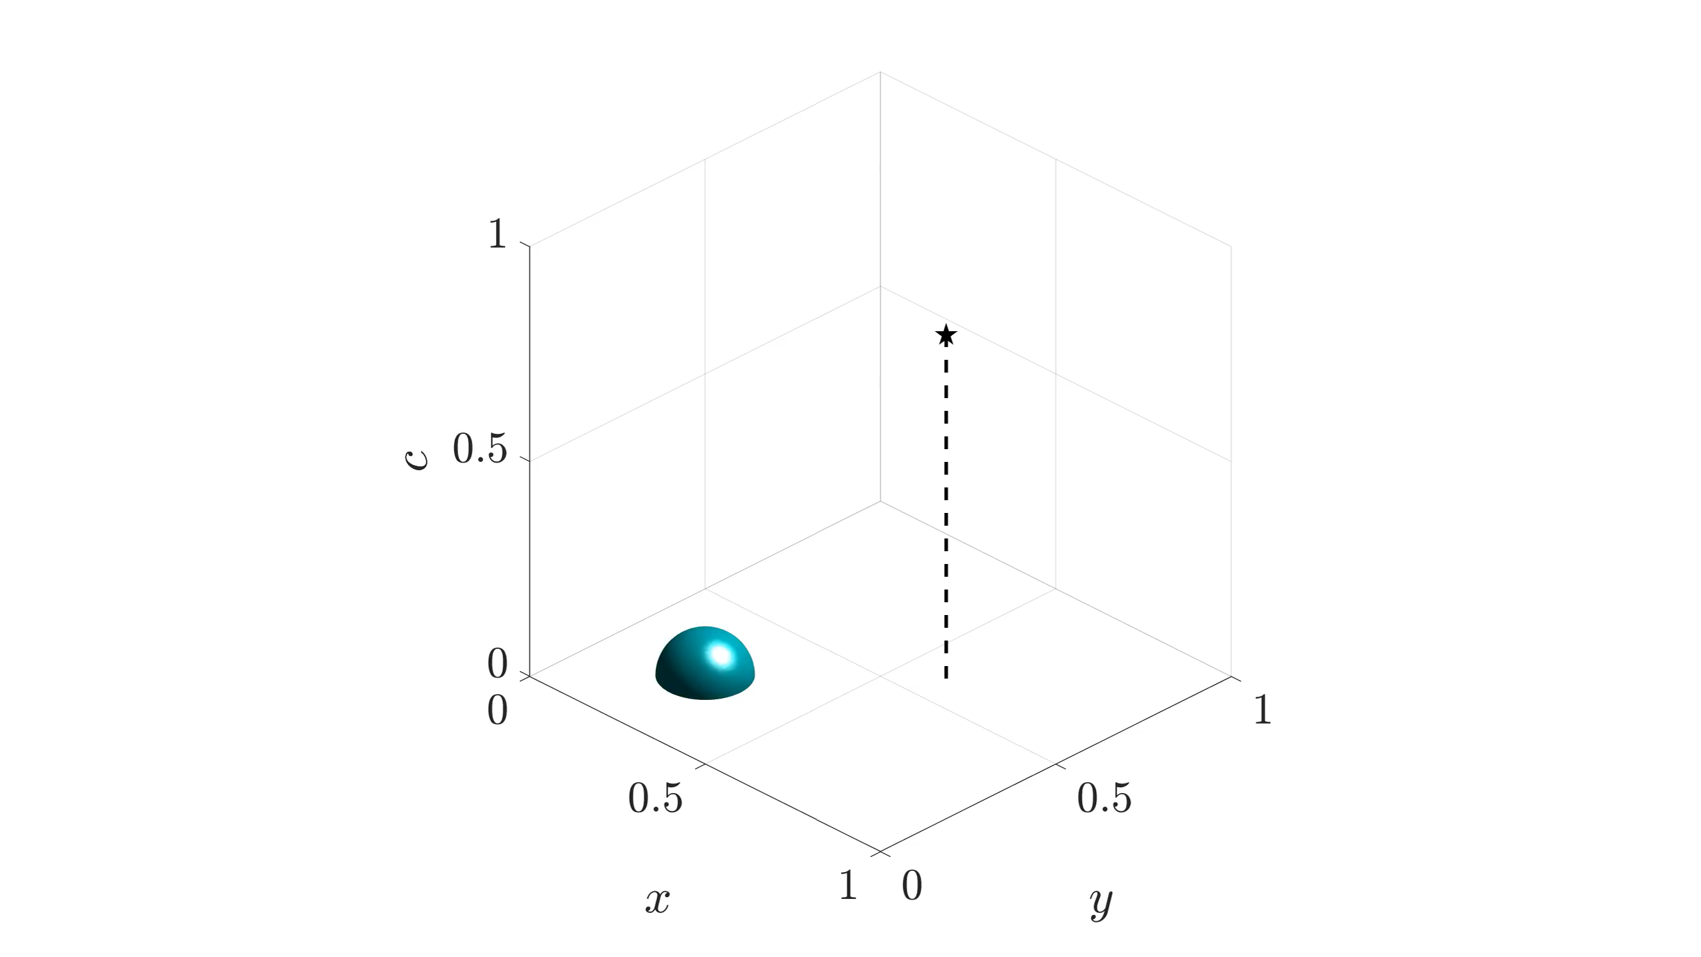
Example 2: Optimal-Collection Validation
To validate that our solver indeed gives us the optimal path, we test it on a case where we have manufactured an analytical solution
13

Slide 14
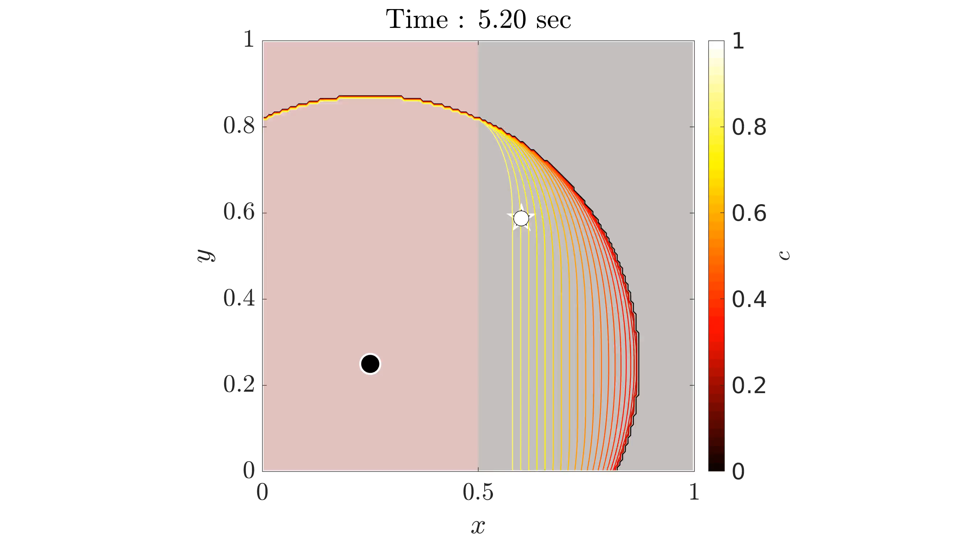
Example 2: Optimal-Collection Validation
14

Slide 15
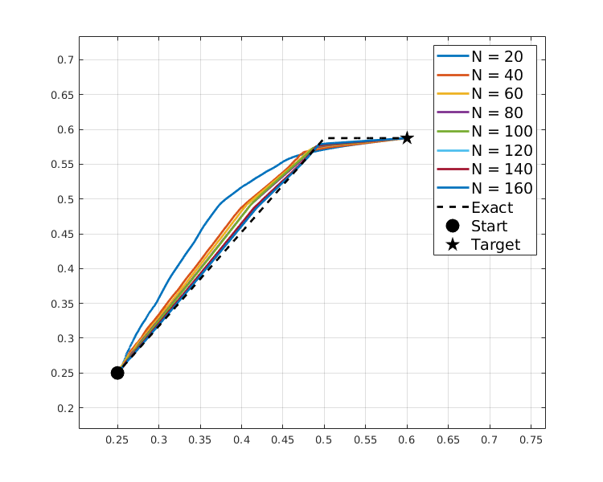
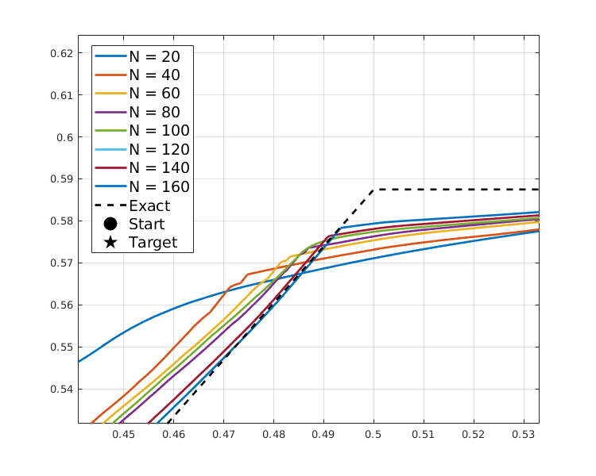
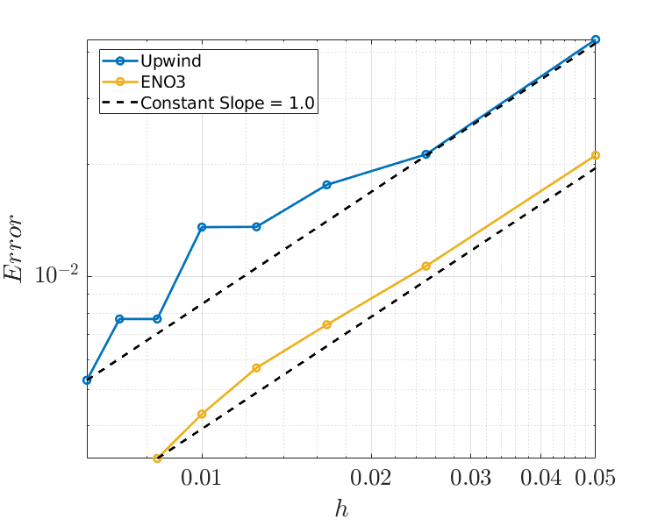
Example 2: Optimal-Collection Validation
15

Slide 16
Special Case 2: Energy-Optimal Path Planning
Hamilton-Jacobi equation for reachability front evolution
Maximization
16
Notes:
Big D to small d

Slide 17
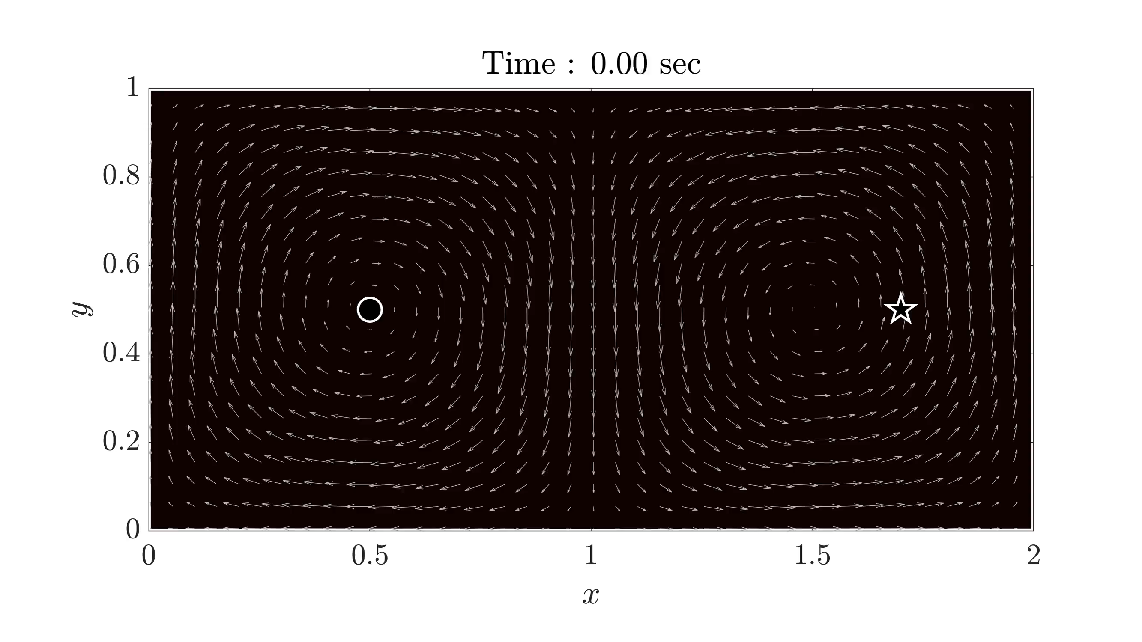
Example 3: Energy-Optimal Path Planning
Start point
Final point
Starting Energy: 0.5
K : 40
Max speed: 0.2
17
Notes:
Note: update with fine case

Slide 18
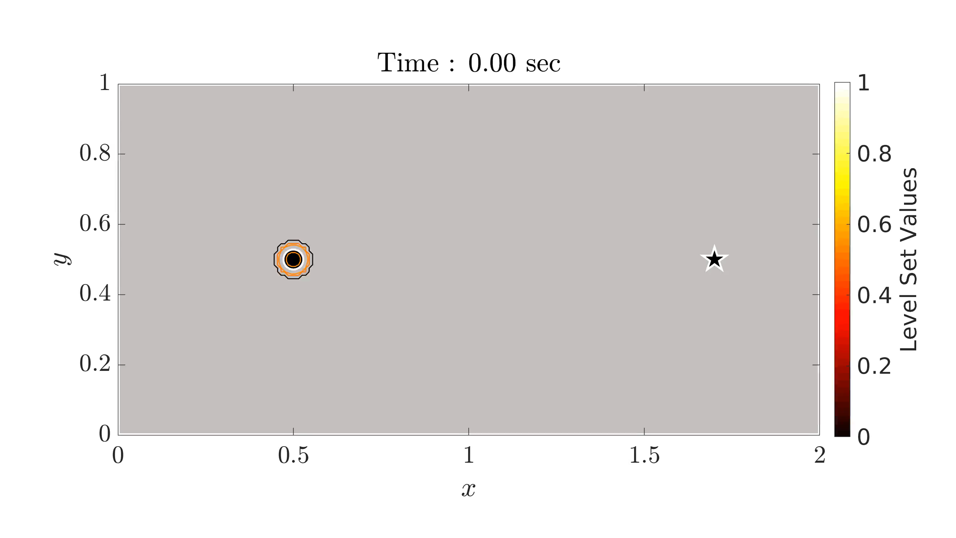
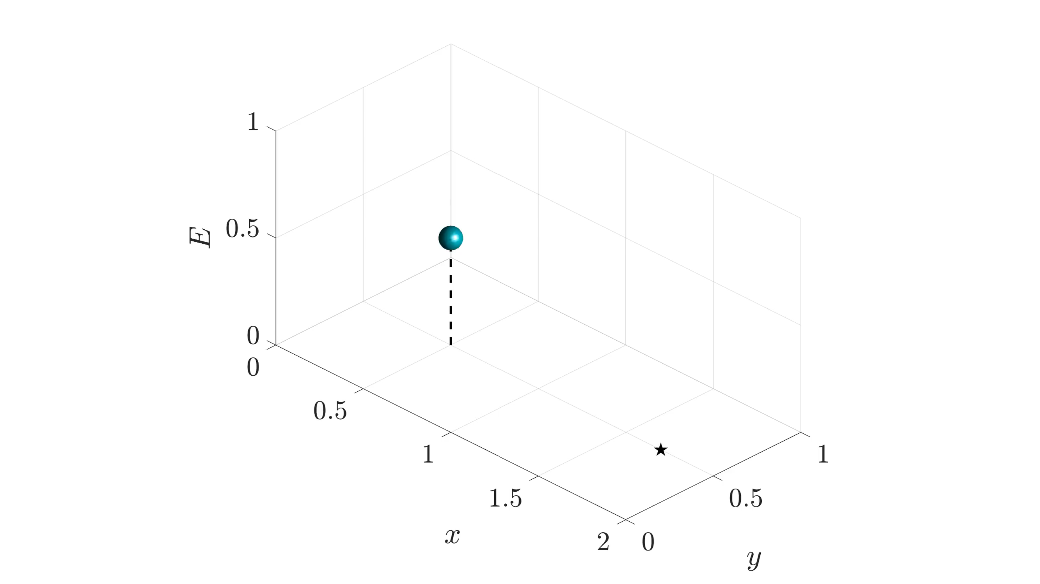
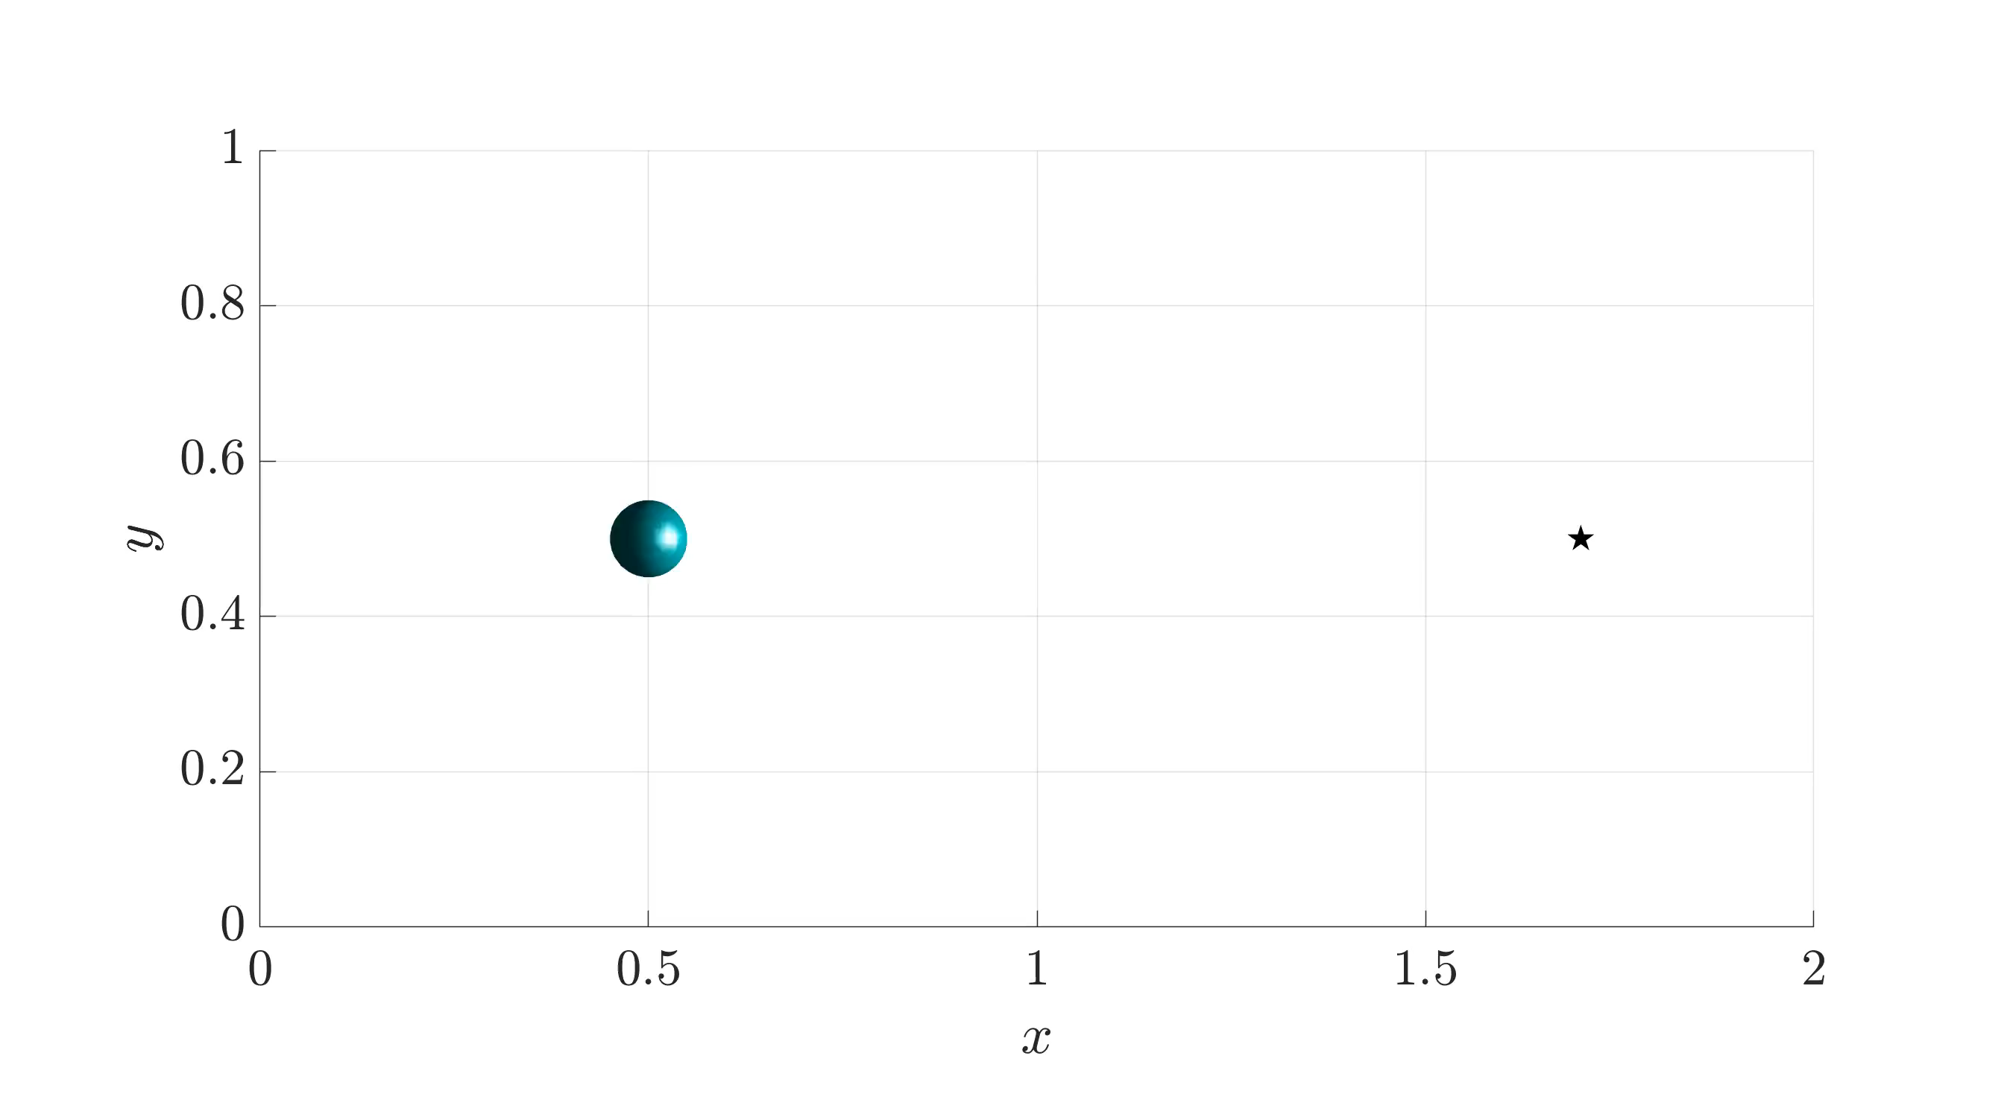
Example 3: Energy-Optimal Path Planning
18
Notes:
Note: update with fine case

Slide 19
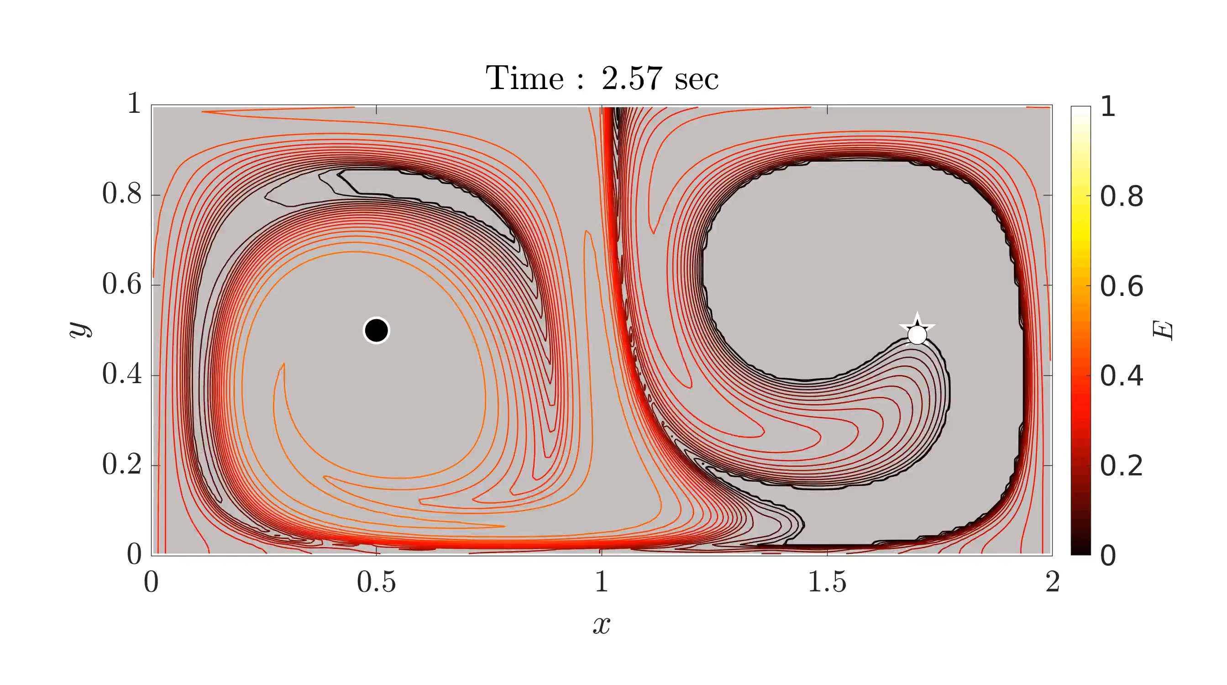
Example 3: Energy-Optimal Path Planning
19

Slide 20
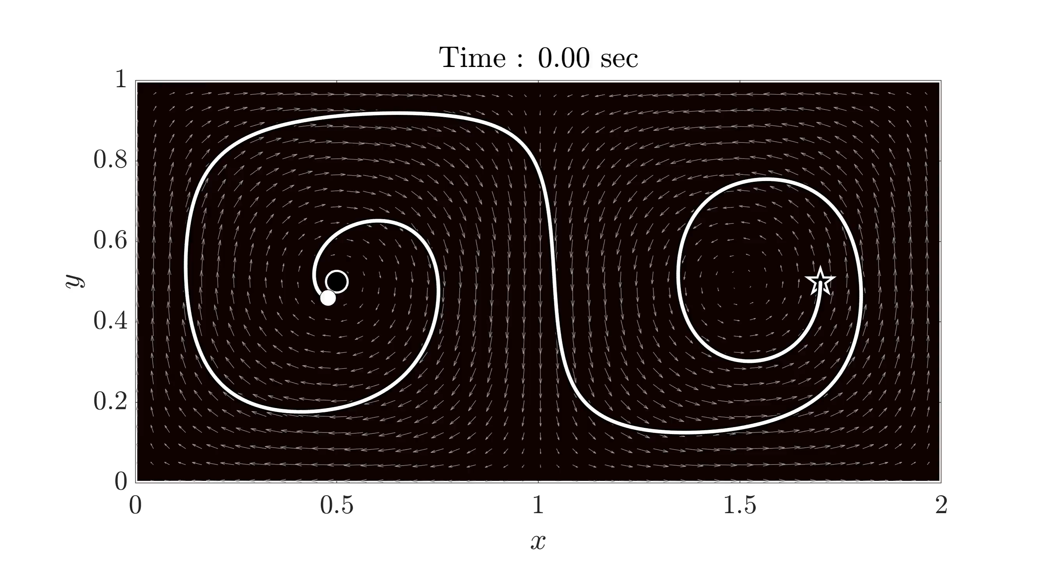
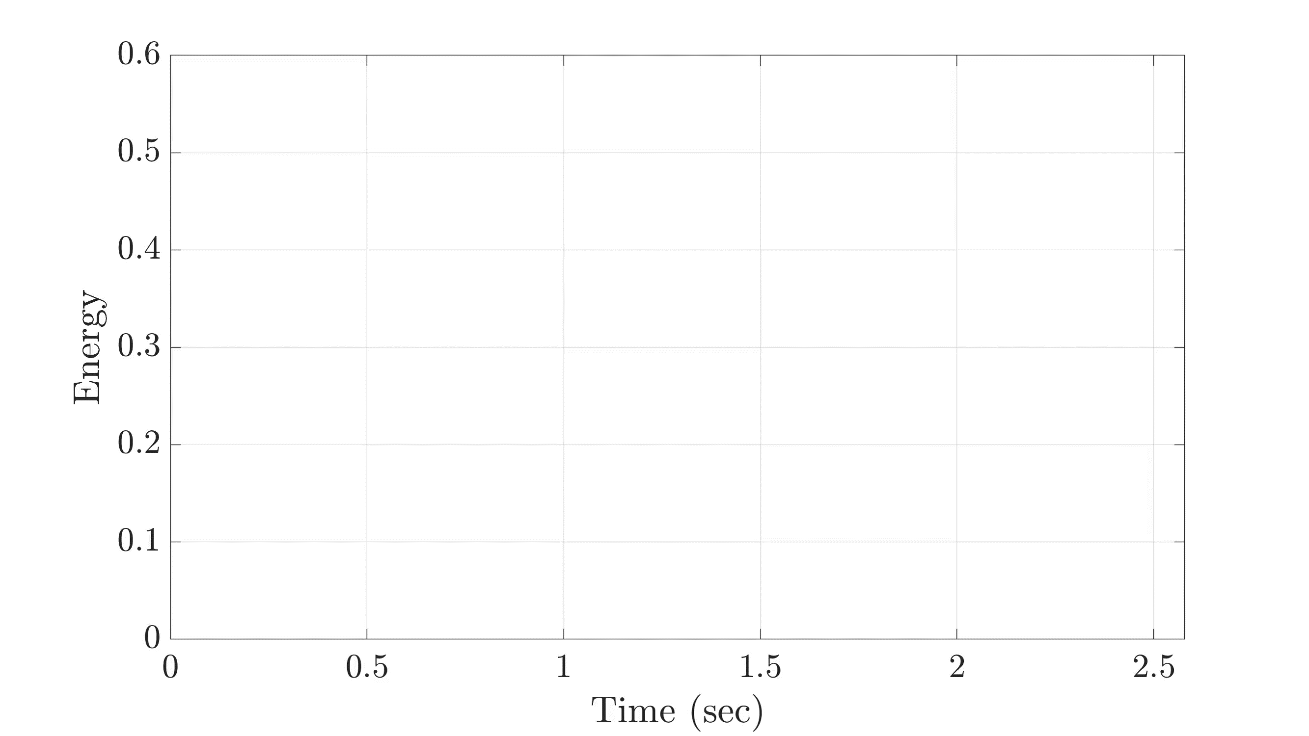
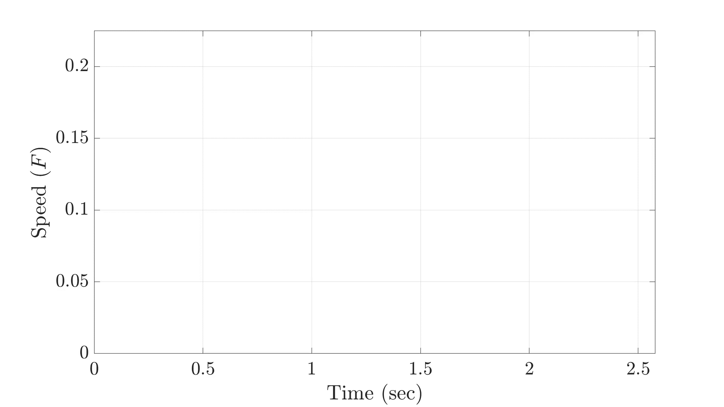
Example 3: Energy-Optimal Path Planning
20

Slide 21
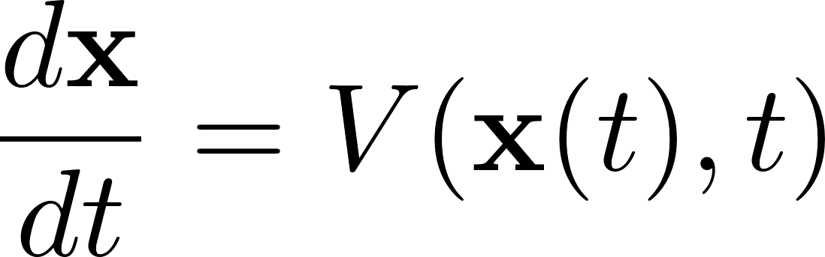
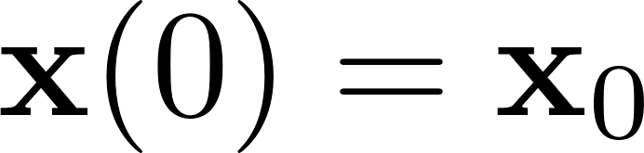
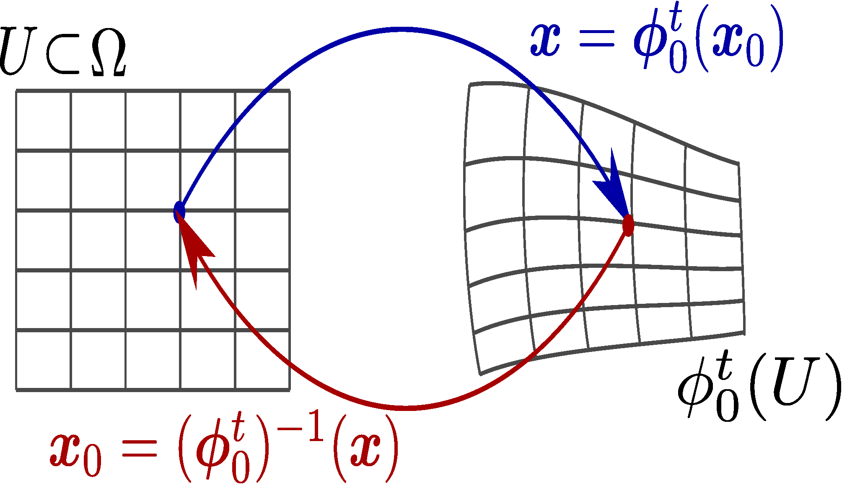
Lagrangian Analysis of Inertial Particles
The Ocean Cleanup
NASA Earth Observatory
Mexico News Daily
Marine Plastic Pollution
Plankton and biomass transport
Sargassum Invasion
Goal: To collect a field of particles, we need to be able to predict how the particles move.
Existing approach: Assume passive particles;
compute flow map;
Governing ODE for passive particles
Forward flow map: Where do particles go?
Backward flow map: Where do particles come from?
Computing the flow map
Run trajectories on a grid of particles to get their final positions
Advection of initial position gives us the backward flow map¹
Forward and Backward PDE advections of positions
Feppon and Lermusiaux, SIAM Review ’18
21
1: Kulkarni, Chinmay, and Lermusiaux, Pierre JCP 2019
Notes:
Outline before jump

Slide 22
Lagrangian Analysis of Inertial Particles
Goal: Given a fluid flow, predict the transport of inertial particles.
How do we integrate inertial particles into this methodology?
Force by undisturbed flow
Buoyancy
Stokes drag
Added mass
Basset-Boussinesq memory term
Governing ODE for inertial particles:
simplified Maxey-Riley equation
Forward flow map
Backward flow map
Flow map is a mapping between initial and final positions
Flow map is a mapping between initial and final positions states
22

Slide 23
Lagrangian Analysis of Inertial Particles
Governing PDE for the flow map: analogous to that of passive particles
Dynamics for passive particles
PDE for computing flow maps
Augmented state dynamics, inertial particles
Augmented PDE
TVD - RK4 with composition
WENO
23
Notes:
Write the full MR eqn with explanation for each term

Slide 24
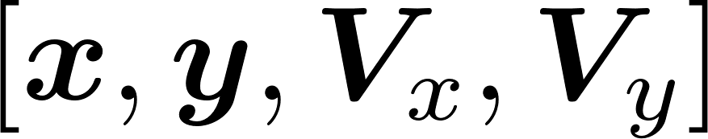
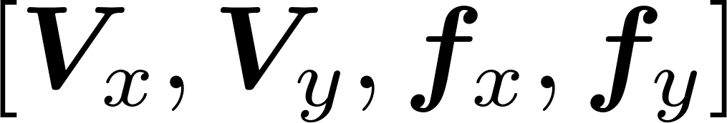
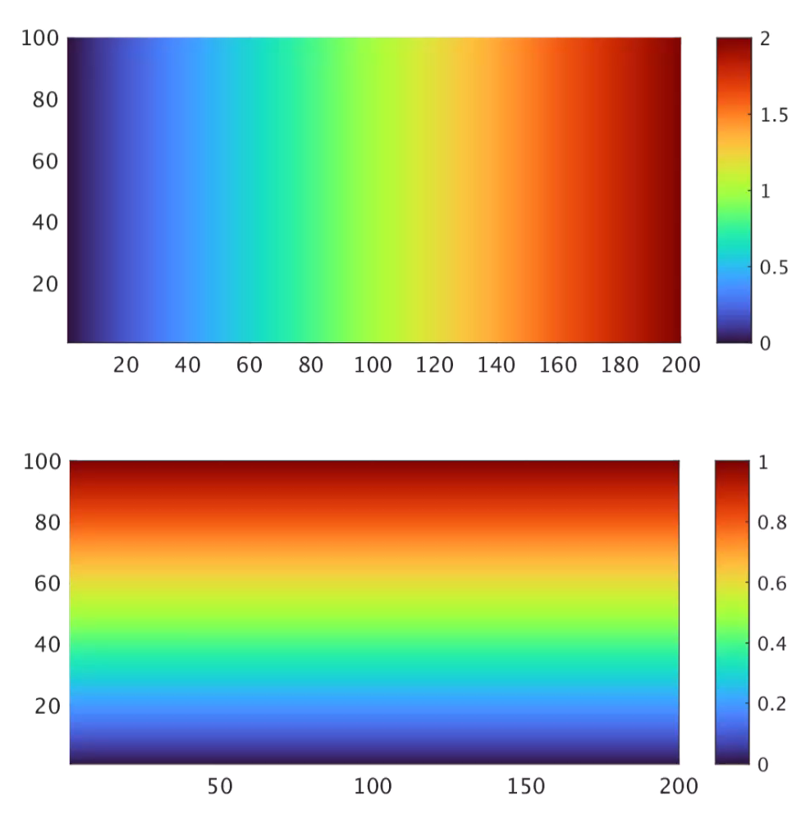
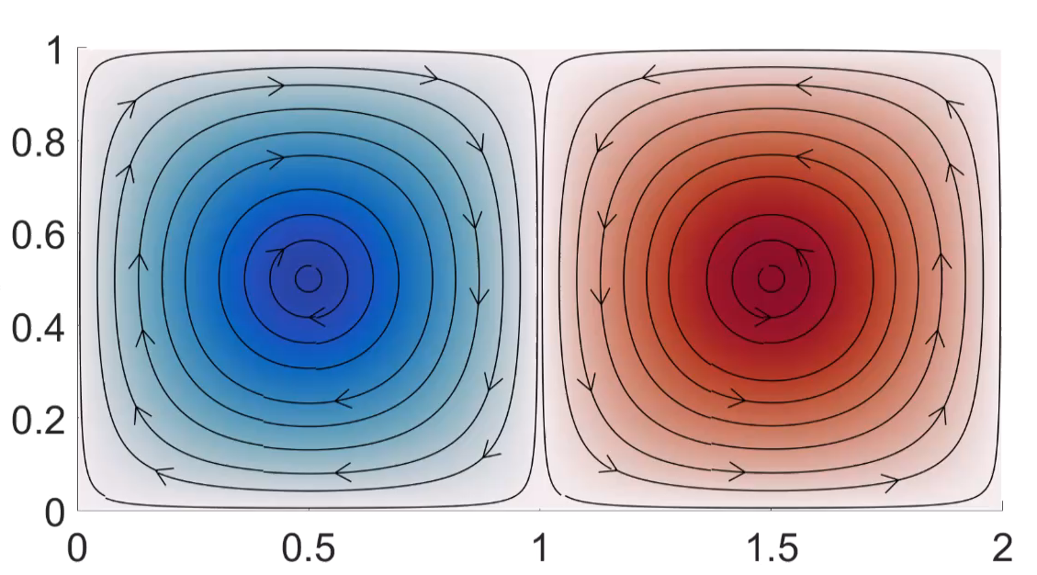
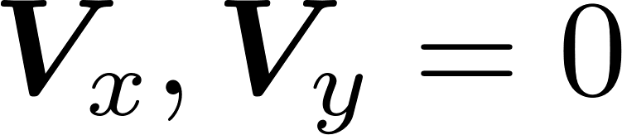
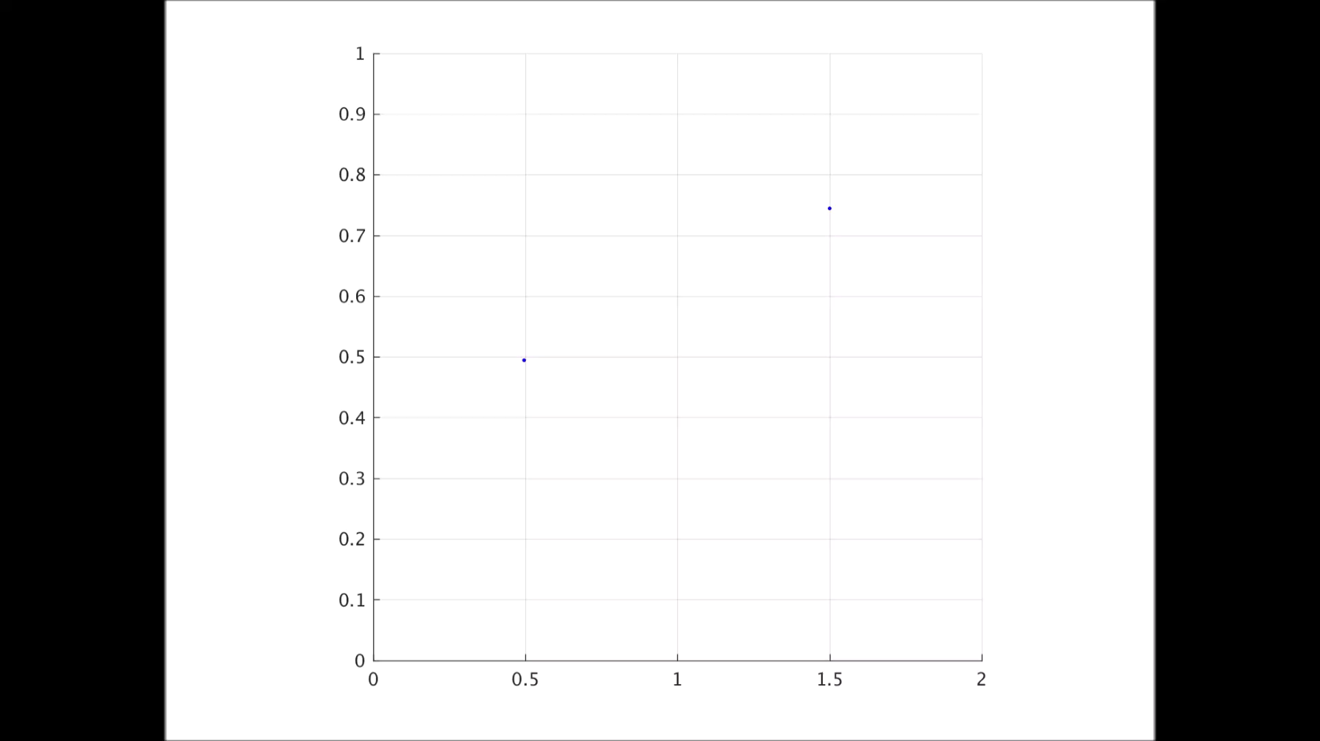
Example: Inertial Particles
  Compute state-augmented flow maps for inertial particles by considering an augmented state space of particle position and velocity, i.e. , its acceleration is:
  Evolve according to the PDE:
  Example: Analytical Double Gyre
  X and Y flow maps at
  Red: Inertial particle
  Blue: Passive particle
Notes:
Density of water: 1000
Density of particles: 1200
Viscosity (nu): 1e-6
Particle size: 1e-3
The flow maps are now 4D (function of x, y, V_x, V_y), so we plot a 2D cross section at V_x = 0 and V_y = 0
That is, these are the final positions of the particles that started at the corresponding x, y locations with zero initial velocity
The white spaces start appearing because particles that started at those locations leave the domain (even though it is a closed domain, inertial particles can leave as they can have enough inertia)
The left two trajectories are extracted from the flow map on the right (which implicitly solves for all trajectories).
The interesting case is of the left particle where the inertial and the non-inertial particles rotate in different directions. This is because the centrifugal acceleration dominates for the inertial particle, and once it gains enough momentum, it continues that direction of rotation

Slide 25

Conclusions and Future Work
Conclusions:
  Optimal-collection path planning
  Derived an exact algorithm for time-optimal collection of background field by extending existing methods for time-optimal path planning
  Demonstrated working examples for energy-optimal and optimal-collection path planning
  Lagrangian Analysis of inertial particles
  Derived a PDE to compute the flow map of inertial particles in a fluid flow
  Demonstrated numerical test case using the higher-dimensional flow map
Future Work
  Optimal-collection path planning
  Implementation in real ocean cases
  Account for cases where the background field is affected by collection
  Account for stochasticity in ocean flow
  Optimal information harvesting and onboard assimilation
  Lagrangian analysis of inertial particles
  Implementation in real ocean cases and inclusion of stochasticity
  Comparison with work on advection of sedimenting plastics
  Assimilation of inertial tracer fields based on tracer observations
25
Notes:
This is more in ‘future work’

Slide 26
Interpreting the flow map
Like for the case of passive particles, we can use the flow maps to now compute various Lagrangian fields that help us understand how inertial particles are transported
26
Notes:
This is more in ‘future work’

Slide 27
Thank You!
27

Slide 28
Extra Slides
28

Slide 29




Viscosity Solution
When characteristics of the hyperbolic PDE intersect, the solution becomes non-differentiable due to formation of shocks
Among all possible weak solutions, viscosity solution picks out the unique solution that satisfies the entropy condition of Sethian
Entropy condition: ‘If the moving level set is a flame front burning unburnt regions, then once a region is burnt, it stays burnt’
Sharp corners arise
even from smooth IC
Sharp IC
Smooth IC
Notes:
PL: you still need to fix this
You need to have a section on “extra slides” which you will show if they ask questions on that topic.
And then, have slides that are old in another section after (most likely, you will not show those)

Slide 30





WENO Scheme
Based on upwinding, but use better approximations for
Use the smoothest polynomial interpolating , and differentiate it (along each dimension)
Decide smoothness by comparing magnitude of the divided differences and choosing the smaller one for each order
End up with 3 possible stencils for :
Use weighted sum of these (weights decided by stencil smoothness)
(similar for )

Slide 31











Godunov Scheme
Look at as
Use upwinding, but here the velocity is
Looking at the X direction:
Case 1
Case 2
Case 3
Case 4

Slide 32
Godunov Scheme
Look at as
Use upwinding, but here the velocity is
Looking at the X direction:
Case 1
Case 2
Case 3
Case 4

Slide 33

Example 3: Energy-Optimal Path Planning, Validation
No flow, no []
Start point
Final point
33

Slide 34

Example 3: Energy-Optimal Path Planning, Validation
The case
Start point
Final point
34

Slide 35














Method of Flow Map Composition
Forward flow map
Backward advection
Forward advection
Independently compute each constituent flow map
Backward flow map
Then
Final equations become:
Interpolate and compose to get the flow map
Forward flow map
Backward flow map
is an interpolation operator to interpolate the new flow map at locations given by the previous flow map
(order of interpolation same as order of advection)
Kulkarni et al., in prep.
Notes:
Once we have these composition equations, then we can use the advection PDE to solve for each of the flow maps
To compute the flow map through composition, initialize a new level set at every timestep and advect it for one timestep.
Note that each of the flow map computation over a time step in independent
We also need to interpolate the values of the new flow map at the values specified by the earlier flow map

