Slide 1
Discontinuous Galerkin Finite Element Methods
2.29 Numerical Fluid Mechanics
Fall 2009 – Special Lecture 2
Mattheus P. Ueckermann
MSEAS Group
Department of Mechanical Engineering
Massachusetts Institute of Technology

Slide 2
Presentation Outline
Background/Motivation
Scalar Advection
Lock Exchange Problem
High-Order on unstructured meshes
Definitions and Notation
Method of Weighted Residuals – Comparison to FV
Concept of Basis and Test Functions
Types of test functions
Types of basis functions
Continuous versus Discontinuous
Worked example
Difficulties and future research
Notes:
30sec

Slide 3
Background/Motivation
DG Advantages
Localized memory access
Higher order accuracy
Well-suited to adaptive strategies
Designed for advection dominated flows
Excellent for wave propagation
Can be used for complex geometries
DG Disadvantages
Expensive?
Difficult to implement
Difficulty in treating higher-order derivatives
Notes:
30sec

Slide 4
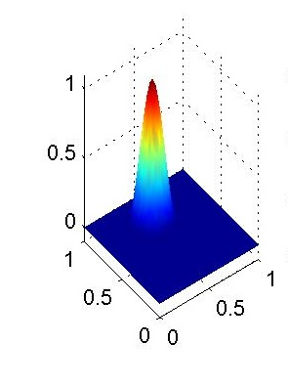
Why Higher Order?
h=0.1
p=6
Time=99.6s
DOF=6,328
Tracer
x
y
Low Order
p=1, Time=260s, DoF=10,300
High Order
p=6, Time=100s, DoF=6,300
Initial Condition
h=0.025,
p=1
Time=261.2s
DOF=10,301
Final Condition
Budgell W.P., et al.. Scalar advection schemes for ocean modelling on unstructured triangular grids. Ocean Dynamics (2007). Vol 57.
Notes:
Label axes, Jump out information about test case Work on it.
Justify use of Higher order. Emphasize Persson’s point that people in general don’t use high enough order. There is an advantage
Looking at different test case
Advection of cone, periodic BC’s 2- periods.
Dispersion of cone, 20% lost, Higher order scheme
Order used depends on: Timestep consideration (length of integration)
Loose DOF for efficiency (got back to bio slide) will be a balance
Cite Leveque (1996)
1 min

Slide 5
Why Higher Order?
Less Numerical Diffusion/Dissipation
Higher accuracy for lower computational time
Example test case: 20 periods of linear tracer advection:
h=0.1
p=6
Time=99.6s
DOF=6,328
Tracer
x
y
Low Order
p=1, Time=260s, DoF=10,300
High Order
p=6, Time=100s, DoF=6,300
Initial Condition
h=0.025,
p=1
Time=261.2s
DOF=10,301
Final Condition
Budgell W.P., et al.. Scalar advection schemes for ocean modelling on unstructured triangular grids. Ocean Dynamics (2007). Vol 57.
Notes:
Label axes, Jump out information about test case Work on it.
Justify use of Higher order. Emphasize Persson’s point that people in general don’t use high enough order. There is an advantage
Looking at different test case
Advection of cone, periodic BC’s 2- periods.
Dispersion of cone, 20% lost, Higher order scheme
Order used depends on: Timestep consideration (length of integration)
Loose DOF for efficiency (got back to bio slide) will be a balance
Cite Leveque (1996)
1 min

Slide 6
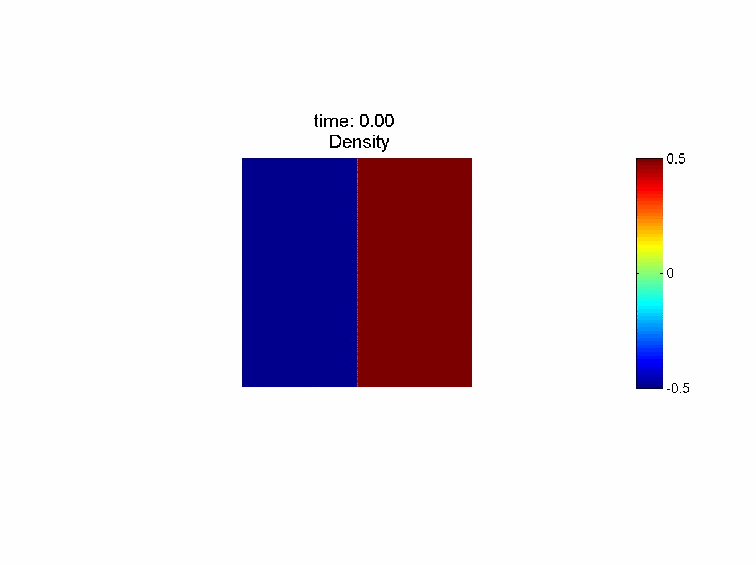
Higher Order Lock Exchange
5th order elements
35 x 35 elements (equivalent to approx 230x230 FV)

Slide 7
Higher Order on unstructured meshes
Large Stencils are difficult
What to do at boundaries?

Slide 8
Definitions and Notation

Slide 9
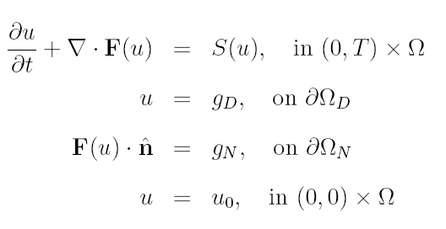
Definitions and Notation
General advection equation

Slide 10
Method of Weighted Residuals (MWR)
Multiply residual by test function
Integrate over domain
Set equal to zero
Integrate by parts
Divergence theorem (weak form)

Slide 11
Test Functions-Function Spaces
If test function is in infinite space
Exact minimization of residual
Discretization of equations leads to finite test function space
w in L2 such that w restricted to K in polynomial space of order p, for all K in triangulation
Two spaces, the normed L² space and Hilbert space
DG --
CG --
Is x²+x+1 in L²? What about H¹? How about δ(x)?

Slide 12
Test Functions
Collocation
Subdomain
Galerkin
Test function is chosen to be the same as the basis function
Often used in practice

Slide 13
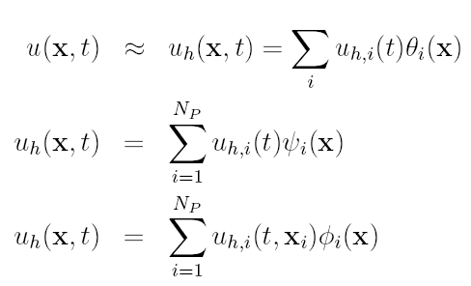
Basis Functions
If basis in infinite space and test function in infinite space
Solution will be exact
Einstein Notation

Slide 14
Basis Functions – Modal vs. Nodal
Nodal
1/2X² - 1/2X
1 - X²
1/2X² + 1/2x
Modal
X²
X
1

Slide 15
Basis Functions – Continuous vs. Discontinuous
Continuous Function Space
Discontinuous Function Space

Slide 16
Discontinuous vs Continuous Galerkin
DG
CG
+₁
_
+₃
+₂
CG has continuity constraint at element edges
Forms matrix with many off-diagonal entries
Difficult to stabilize hyperbolic problems
DG has no continuity constraint
Local solution in each element
Two unknowns on either side of element edges
Connection of domain achieved through fluxes: combination of unknowns on either side of edge
Forms matrix with block-diagonal structure

Slide 17
Worked Example
Choose function space
Apply MWR

Slide 18
Worked Example
Substitute in basis and test functions

Slide 19
Worked Example
Substitute for matrices
M- Mass matrix
K- Stiffness matrix or Convection matrix
Solve specific case of 1D equations

Slide 20
Worked Example

Slide 21
Worked Example
clear all, clc, clf, close all syms x %create nodal basis %Set order of basis function %N >=2 N = 3; %Create basis if N==3 theta = [1/2*x^2-1/2*x; 1- x^2; 1/2*x^2+1/2*x]; else xi = linspace(-1,1,N); for i=1:N theta(i)=sym('1'); for j=1:N if j~=i theta(i) = ... theta(i)*(x-xi(j))/(xi(i)-xi(j)); end end end end | %Create mass matrix for i = 1:N for j = 1:N %Create integrand intgr = int(theta(i)*theta(j)); %Integrate M(i,j) =... subs(intgr,1)-subs(intgr,-1); end end %create convection matrix for i = 1:N for j = 1:N %Create integrand intgr = ... int(diff(theta(i))*theta(j)); %Integrate K(i,j) = ... subs(intgr,1)-subs(intgr,-1); end end

Slide 22
Worked Example
%% Initialize u Nx = 20; dx = 1./Nx; %Multiply Jacobian through mass matrix. %Note computationl domain has length=2, actual domain length = dx M=M*dx/2; %Create "mesh" x = zeros(N,Nx); for i = 1:N x(i,:) =... dx/(N-1)*(i-1):dx:1-dx/(N-1)*(N-i); end %Initialize u vector u = exp(-(x-.5).^2/.1^2); %Set timestep and velocity dt=0.002; c=1; %Periodic domain ids = [Nx,1:Nx-1]; | %Integrate over time for i = 1:10/dt u0=u; %Integrate with 4th order RK for irk=4:-1:1 %Always use upwind flux r = c*K*u; %upwinding r(end,:) = r(end,:) - c*u(end,:); %upwinding r(1,:) = r(1,:) + c*u(end,ids); %RK scheme u = u0 + dt/irk*(M\r); end %Plot solution if ~mod(i,10) plot(x,u,'b') drawnow end end

Slide 23
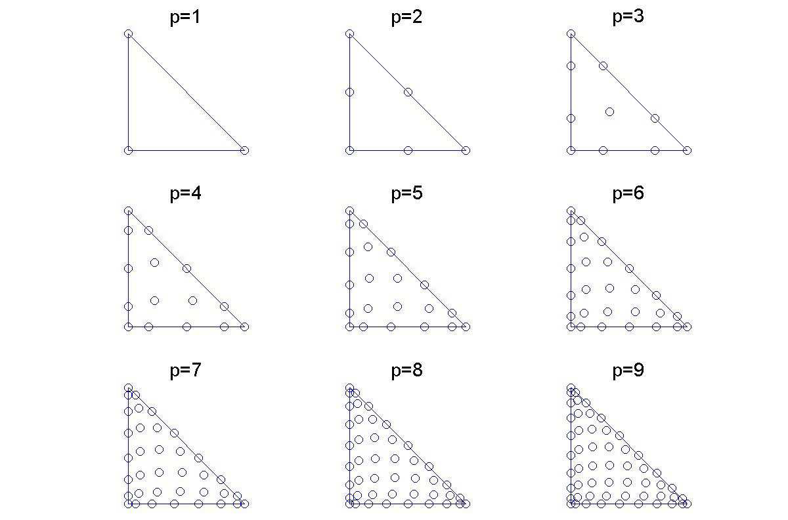
Difficulties
How to create basis on triangles, tetrahedrals?
Need to create set of well-behaved Nodal point
Integration in 2D, 3D?
Higher-order quadrature rules on triangles, tetrahedrals

Slide 24
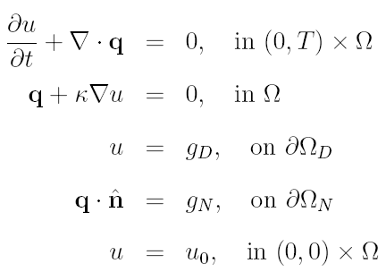
Difficulties and future research
Higher-order derivatives
Naturally handled with CG
Somewhat more difficult with DG
Decompose higher derivatives into system of first-order derivatives

Slide 25
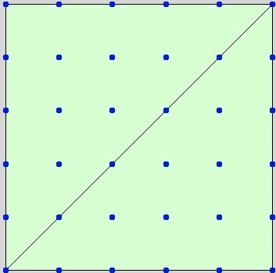
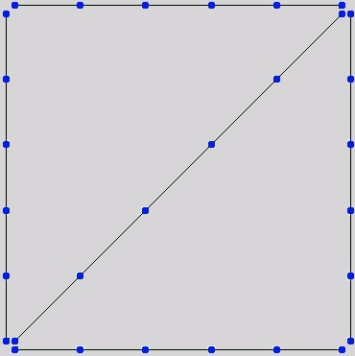
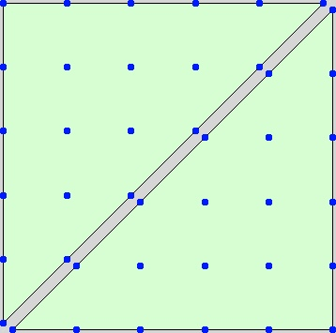
Difficulties and future research
Research directed towards improved treatment of higher-order derivatives
Hybrid Discontinuous Galerkin
Continuous Galerkin
Discontinuous Galerkin
No duplication of DOF
Duplication at corners, but no interior DOFs!
Duplication at edges

Slide 26
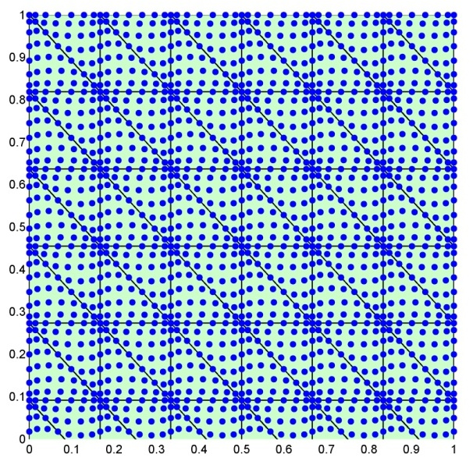
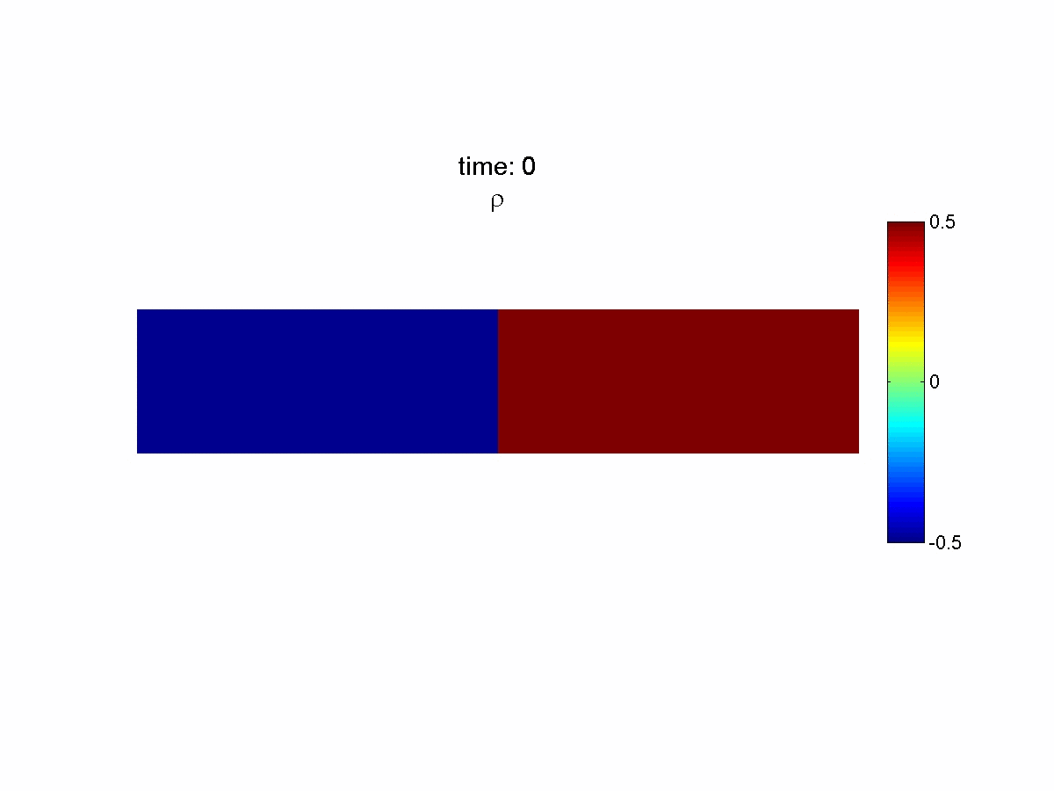
Lock Exchange Problem using HDG
37,000 DOF, 14,000 HDG unknowns
13.5 hrs
1320 Elements
p=6
Gr = 1.25x10⁶, Sc=0.71
Hartel, C., Meinburg, E., and Freider, N. (2000). Analysis and direct numerical simulations of the flow at a gravity-current head. Part 1. Flow topology and front speed for slip and no-slip boundaries. J. Fluid. Mech, 418:189-212.

Slide 27
Lock Exchange Problem
Time = 5
Time = 10
37,000 DOF
23,000 DOF
Hartel, C., Meinburg, E., and Freider, N. (2000). Analysis and direct numerical simulations of the flow at a gravity-current head. Part 1. Flow topology and front speed for slip and no-slip boundaries. J. Fluid. Mech, 418:189-212.

Slide 28
References
Discontinuos Galerkin
Hesthaven J.S. and T. Warburton. Nodal Discontinuous Galerkin Methods. Texts in applied mathematics 54, (2008)
Nguyen, N. C., Peraire, J., and Cockburn, B. (2009). An implicit high-order hybridizable discontinuous galerkin method for linear convection-diﬀusion equations. Journal of Computational Physics, 228(9):3232-3254.
Cockburn, B., Gopalakrishnan, J., and Lazarov, R. (2009). Uniﬁed hybridization of discontinuous galerkin, mixed, and continuous galerkin methods for second order elliptic problems. Siam Journal on Numerical Analysis, 47(2):1319-1365.
General FEM
Brenner S.C. and L.R. Ridgway Scott. The Mathematical Theory of Finite Element Methods. Texts in applied mathematics 15, (2002)
P.G. Ciarlet and J.L. Lions. Handbook of Numerical Analysis. Volume II: Finite Element Methods (Part 1), (1991).

