Slide 1
ACCOMPLISHMENTS:
2016 Bismarck Sea Simulations Set-up
Pierre Lermusiaux, Patrick Haley, Jade Coulin
SRMT15 Bathymetry
Vertical Discretization: 70 optimized vertical levels
Tidal Forcing: new, high resolution TPXO8-Atlas from OSU
Reprocessed for higher resolution bathymetry & quadratic bottom drag
Tuned to historical current data
1/12 HYCOM Initial Conditions
Velocities optimized for high-res. coasts/bathymetry [Haley et al, 2015]
Acquired higher resolution (1/25º) HYCOM
Possible future upgrades
Higher resolution bathymetry with nesting and tiling
atmospheric forcing
Dynamically-Orthogonal PEs for large ensemble forecasting
Data Assimilation (Error Subspace Statistical Estimation for Ensemble Forecasting)
Coupled plume modeling, tracer release simulations
Lagrangian Coherent Structure analysis[Feppon and Kulkarni, in prep]
Scenario analysis

Slide 2
ACCOMPLISHMENTS:
2016 Bismark Sea Simulations
0m Temperature Std. Dev.
Surface Temperature
Multiscale simulations
Interaction between tides and background currents strengthen currents through straits
Tides modulate flow through straits rather than cause reversals
Surface Velocity

Slide 3
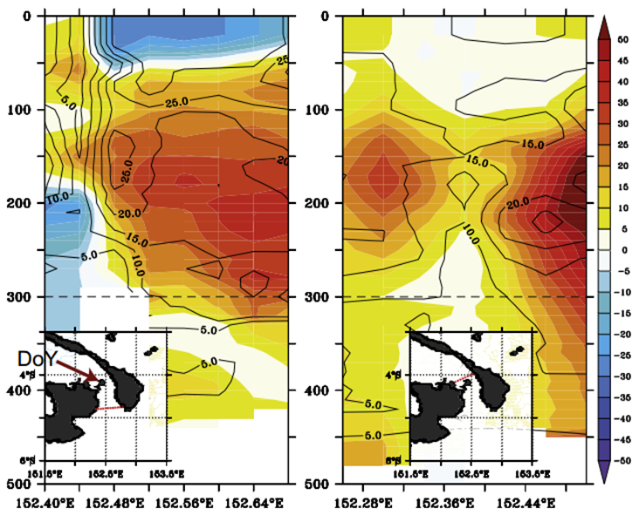
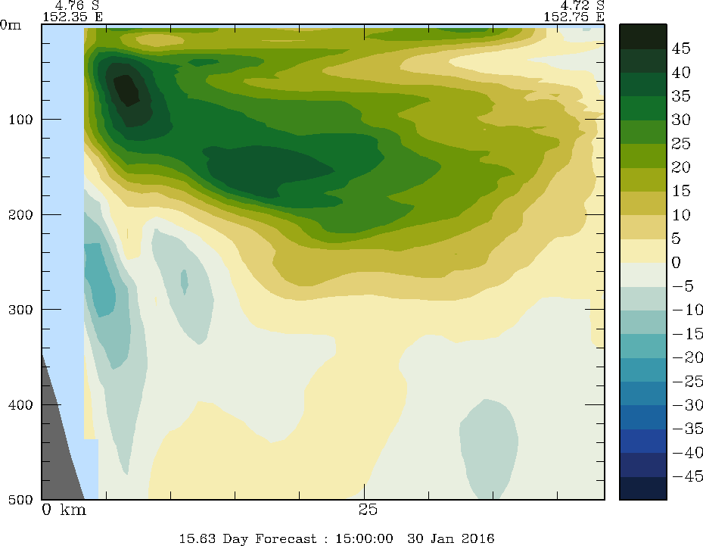
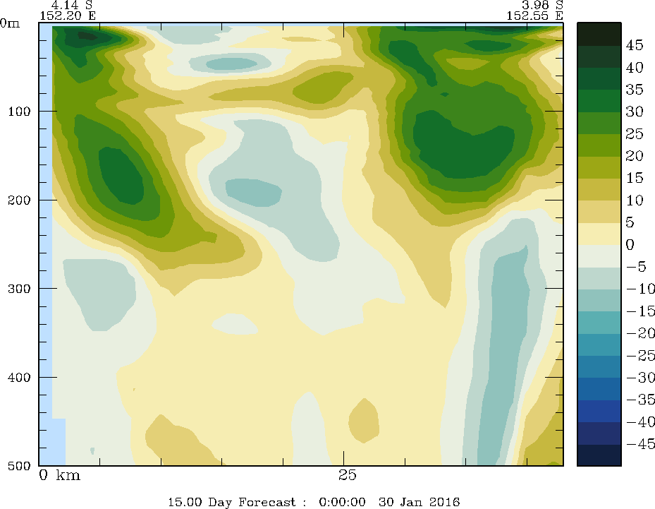
ACCOMPLISHMENTS:
Comparing to Historical Data
Average through-channel velocity from ADCP data
MSEAS PE through-channel velocities
[Cravatte et al. 2011 Prog Oceanog.]
Comparing estimates of through-channel currents in St. Georges Channel from averages of shipboard ADCP from 6-8 cruises to simulation estimates of through-channel currents in same sections
Qualitatively have similar features. Quantitative features need more tuning.
Future work will include use of available synoptic data for initialization and assimilation and atmospheric forcing

