Slide 1
MIT MSEAS Activities
Multi-resolution downscaling from HYCOM (1/12º) to high-res. Island domains (e.g. May-June 2015, May-June 2016, Jan 2017)
MIT-MSEAS (hydrostatic PE, nonlinear free-surface, tides)
Implicit 2-way nested telescoping and tiling modeling domains
Larger domains (1/25º, 1/75º) provide BCs (internal tides, larger-scales, etc.) to set of finer domains: Guam (1/75º, 1/225º), Palau/Yap (1/225º), and Velasco Reef (1/675º). Higher-res. improved fct skill (Argo comparison)
Studies of interactions at abrupt topography around Palau
Focus: regional currents, internal tides, eddies shedding, transports
Variability of internal tides (slowly-varying background effects on ITs)
2D and 3D Lagrangian Coherent Structures and rigid/coherent sets
Non-hydro. generation of solitons and gravity current interactions with tides (using our finite-element HDG code)

Slide 2
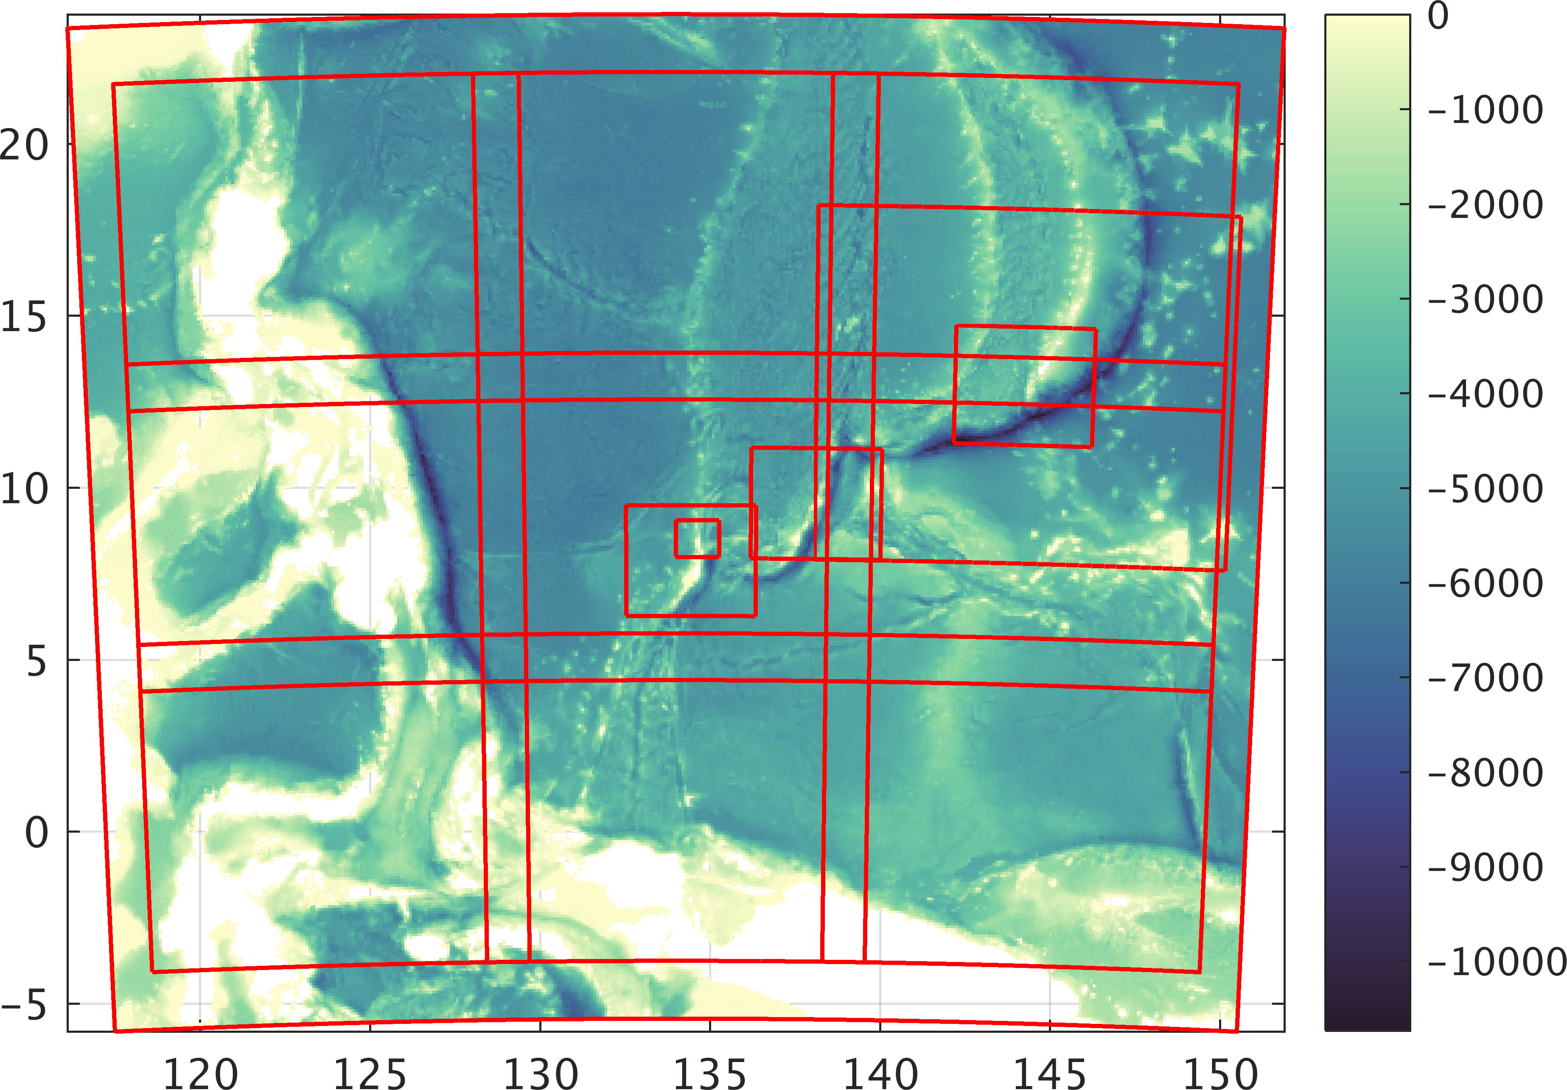
Telescoping Domains: Implicit 2-way Nesting and Tiling
(1/25º, 1/75º, 1/225º, 1/675º)
D2
D3
D3
D4
D3
D2
D1
D1, ten D2, three D3 & one D4 domains

Slide 3
MIT-MSEAS
FLEAT Simulations Set-up
SRMT15 Bathymetry
Vertical Discretization: 70 optimized vertical levels
Tidal Forcing: new, high resolution TPXO8-Atlas from OSU
Reprocessed for higher resolution bathymetry & quadratic bottom drag
Atmos. Forcing: NCEP GFS (1/4º).
1/12 HYCOM Initial and Open Boundary Conditions
Velocities optimized for high resolution coasts/bathymetry [Haley et al, 2015]
Acquired higher resolution (1/25º) HYCOM
Improved nesting and tiling capabilities
Allow for arbitrary number of overlapping sub-domains
Ongoing upgrades
Higher resolution bathymetry/ atmospheric forcing
Dynamically-Orthogonal PEs for large ensemble forecasting
Increased Data Assimilation

Slide 4
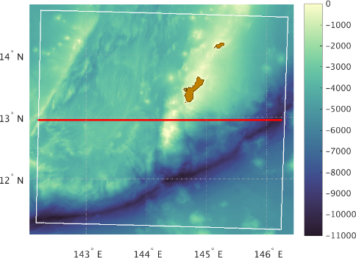
Vertical Structure of sound speed along 13N – Jan 2017
Internal tides/waves introduce sharp variations in sound speed above the sound speed minimum (especially in thermocline above shallow & abrupt topography)
Little variation introduced at depths much below sound speed minimum

Slide 5
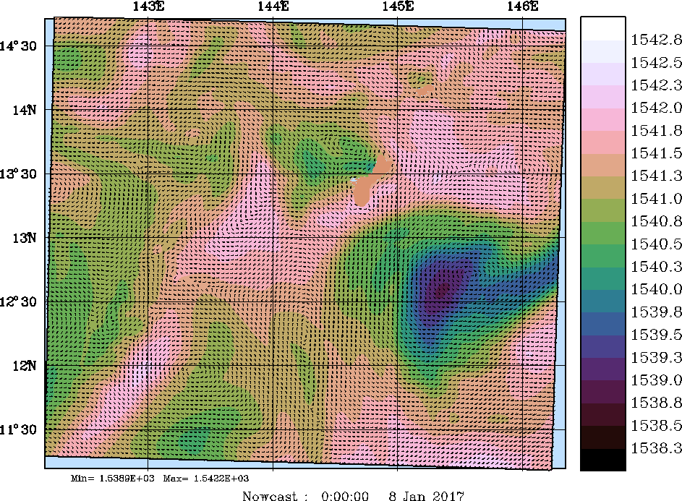
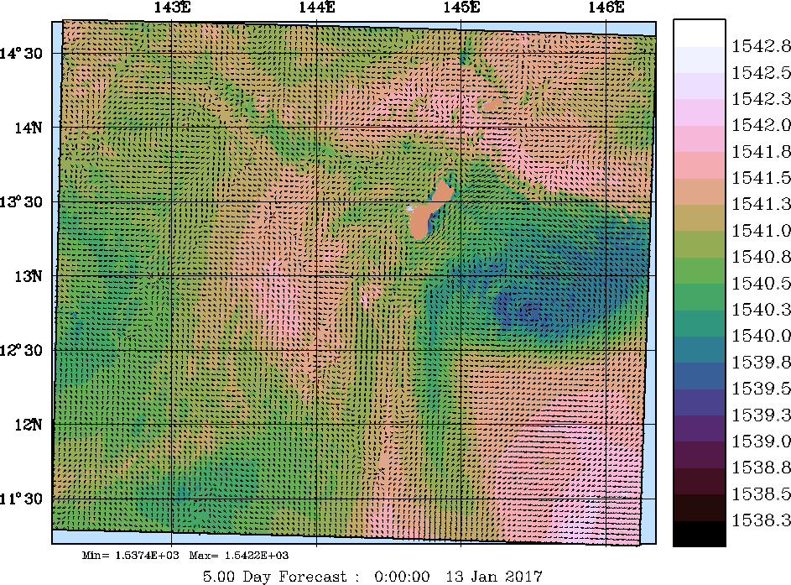
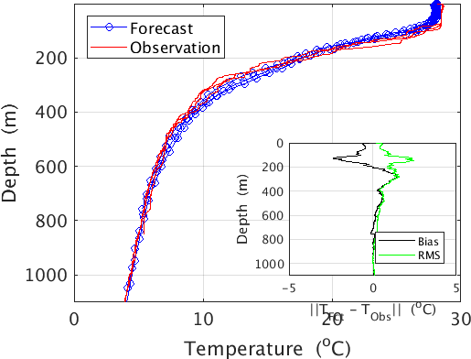
Simulations for Acoustic Studies: Guam - 2017
30m c - Nowcast 8 Jan 2017
Forecast 13 Jan 2017
Forecast - XBT Data Comp.
New hindcast simulations for acoustic studies of January 9-13, 2017 exercise [tiling + implicit 2-way nesting downscaled from HYCOM to 1/225º res.]
Vorticity: effects of ITs and eddies downstream of islands, as well as wind forcing resetting surface state by “mixing + advecting of small scales”
Validated using XBT data from 2017 cruise
Fields provided to K. Heaney & P. Abbot

