Slide 1
LCE Cardone Formation: 12Z Feb 20 to 0Z Mar 7
MSEAS 2m Scaled Vorticity Forecasts
1/25° real-time simulation
ICs downscaled from Feb 20 Mercator Fcst
Corrected by available data
No DA during simulation
Covers period of initial separation of LCE Cardone
Good agreement with observed March 4 separation https://www.horizonmarine.com/loop-current-eddies
Notes:
Deep (500m at least) cyclonic eddy around 25.5N and 86.5W is there already around Feb 17. It seems the surface component of this LCFE (Loop Current Frontal Eddy) is strengthened by wind event on Feb 17-19.
Stronger than usual cyclonic eddies and meanders on the western LC wall, advected on edges of LCE, feed cyclonic eddy on the wes strenghtern LC.
A large anticyclonic eddy in the Caribbean Sea off the Yucatan Channel goes through the channel in two main bursts (first Feb 26-28, then most Mar 1-4), and a third one a bit later.
With cyclonic eddy, this anticyclonic eddy forms conditions for separation, LC turns eastward.
Note another anticyclone is forming off Mexico in Caribbean Sea, hence not all lead to LCE detachment.

Slide 2
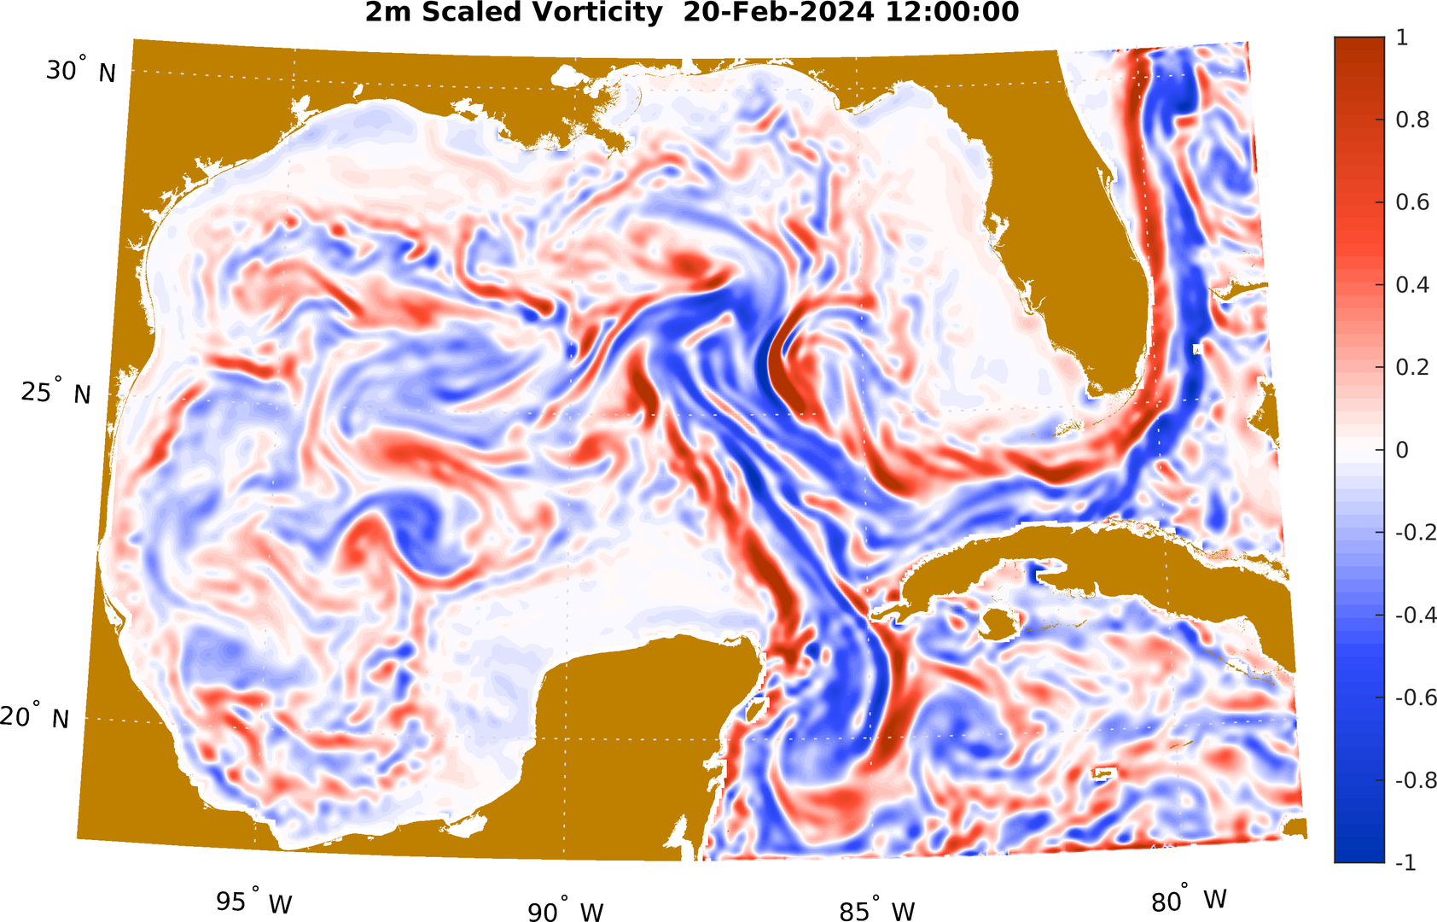
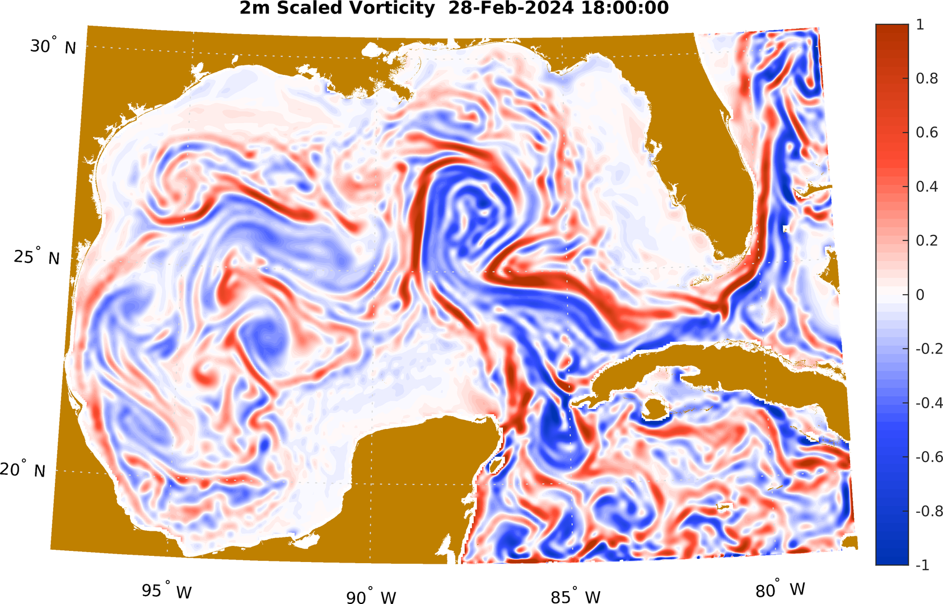
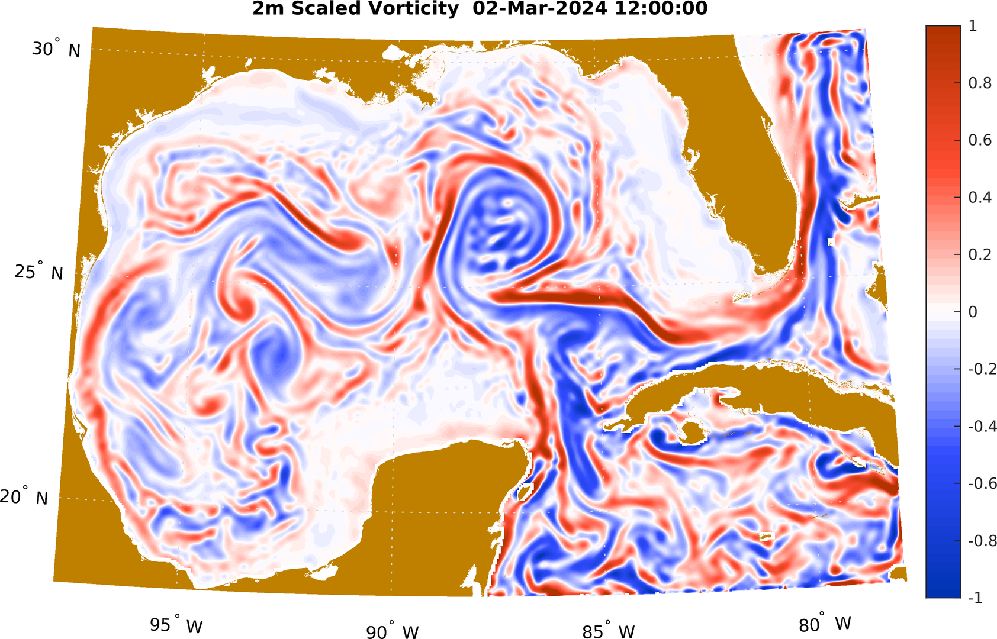
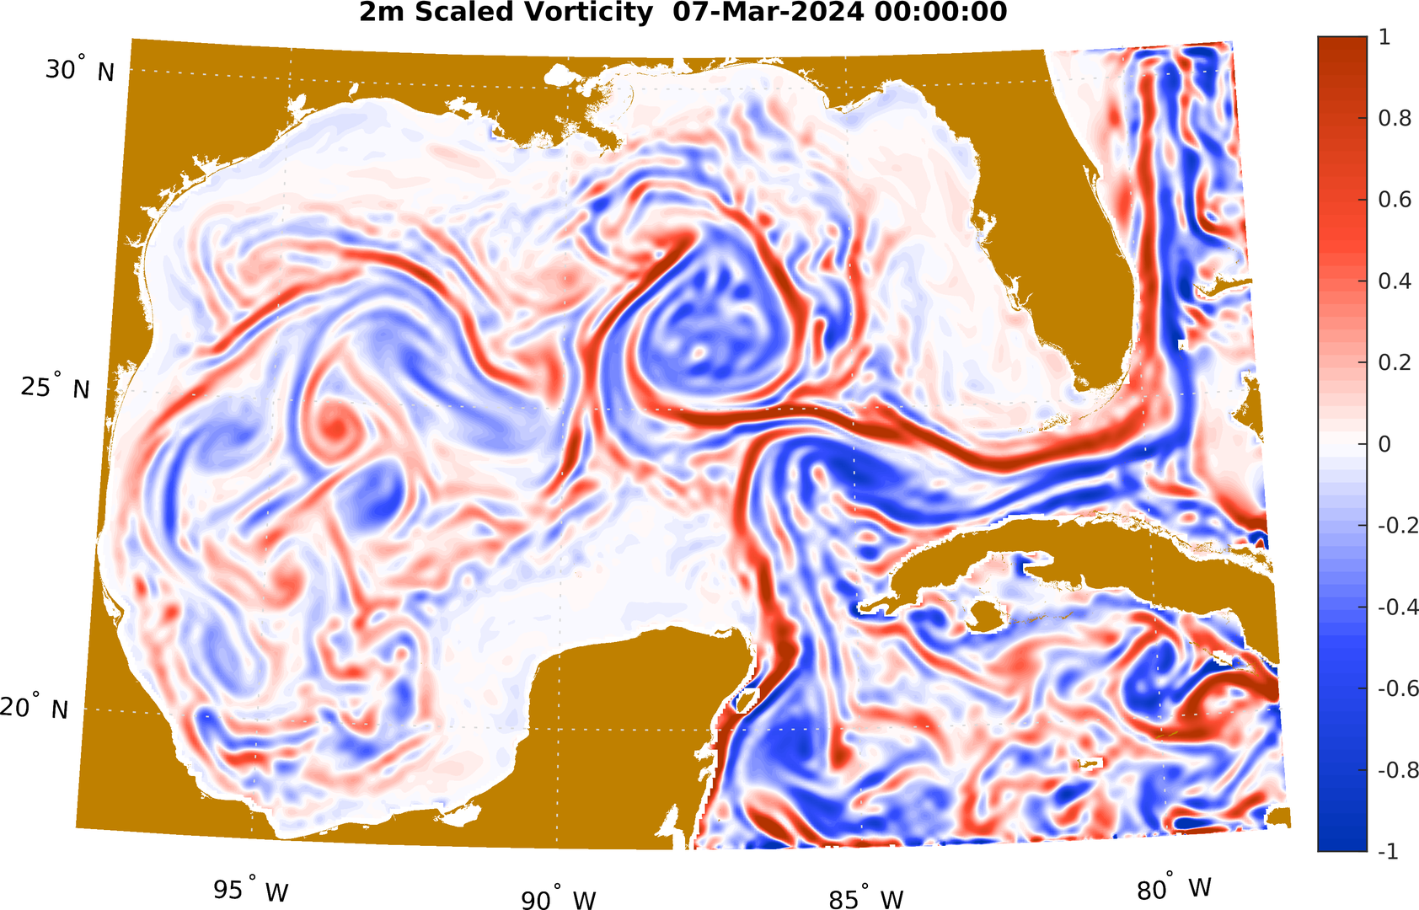
LCE Cardone Formation: 12Z Feb 20 to 0Z Mar 7
MSEAS 2m Scaled Vorticity Forecasts
Feb 20 12Z
LCFE forming; anticyclone east of Yucatan
Feb 28 18Z
Burst #1 of negative vorticity through YC; LCFE barrier eddy fully formed
Mar 2 12Z
Burst #2 of negative vorticity through YC
Mar 7 0Z
LCE Cardone fully separated

Slide 3
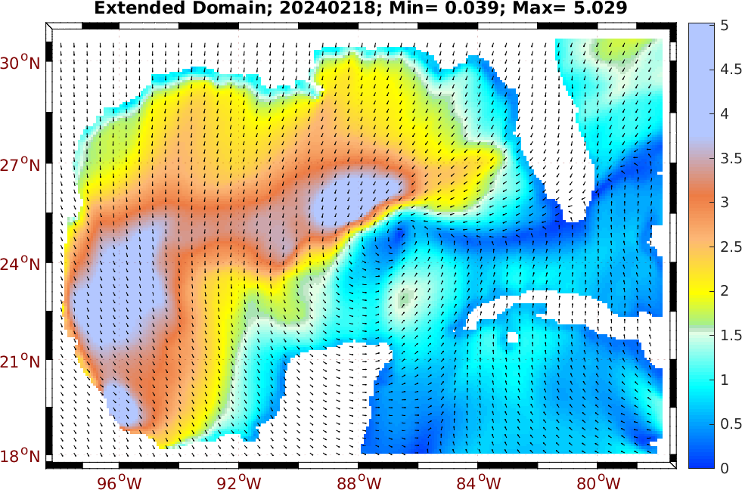
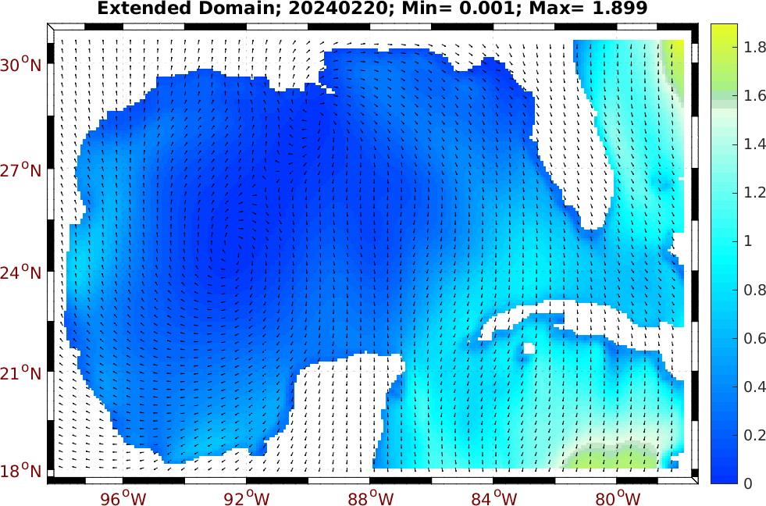
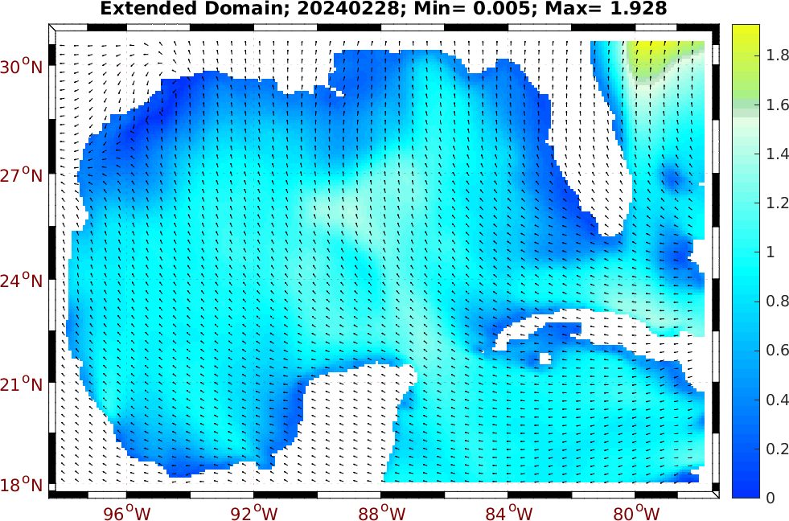
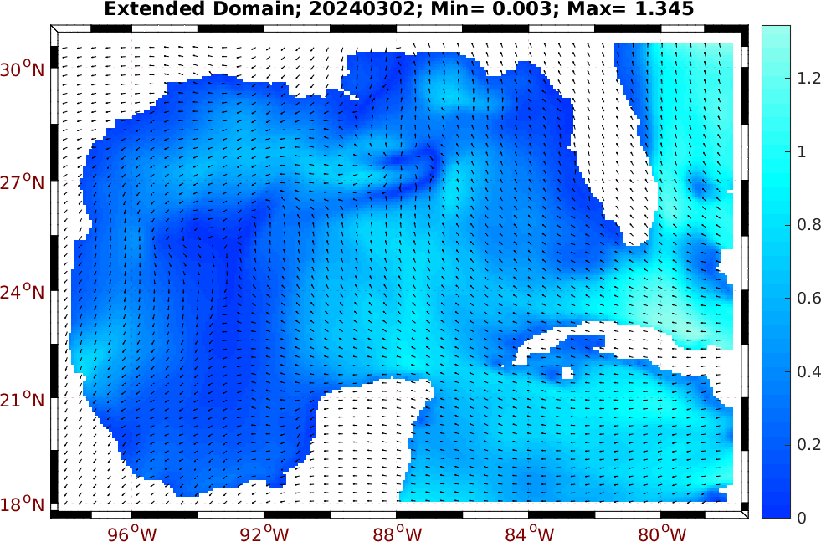
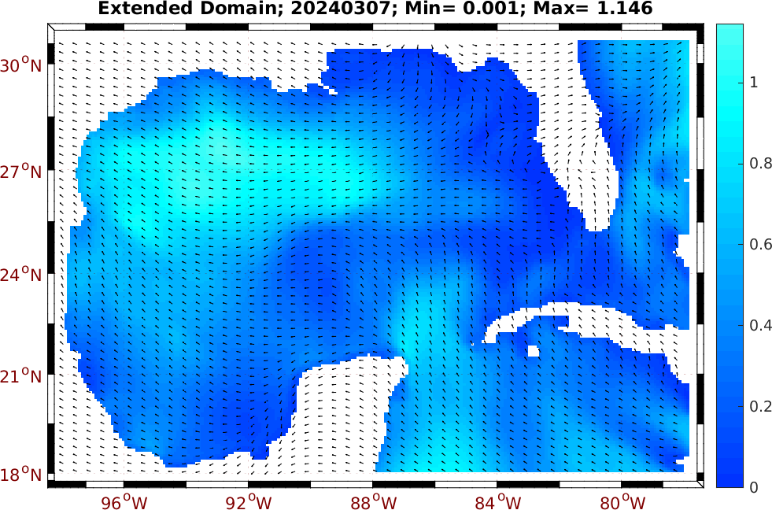
Effect of Winds on LCE Cardone Formation: Feb 20 to Mar 7, 2024
February 18
February 20
February 28 (Burst #1)
Daily average wind stress (dyne cm⁻²) from NCEP NAM 3km hourly
Gale occurs on Feb 18, 2 days before simulation begins
Moderate winds directed NW through the YC on Feb 28
Winds subside after Feb 29, but remain directed NW through the YC
Winds from Feb 28 to Mar 7 encourage northward transport through YC
March 2 (Burst #2)
March 7
1 dyne cm⁻² = 0.1 N m⁻²

Slide 4
MSEAS-PE Evolution of Backward Flowmaps (100 m): Feb 20 – Mar 7, 2024
X-Flowmap
Y-Flowmap
Z-Flowmap
Backward flow maps display the initial position of a water parcel at its final location as it is advected over a specified time window (“field version” of classic trajectories)
Surface component of cyclonic eddy (LCFE) around 25.5N and 86.5W strengthened, possibly due to Feb 17-20 gale winds (to west-southwest)
Cyclonic eddies and meanders on western LC wall are advected around edges of LCE
Florida shelf water entrained in the LCE separation
Interactions with smaller eddies in western Gulf advect western Gulf water to the edge of the LCE
Notes:
LCFE Loop Current Frontal Eddy (cyclonic eddy)

Slide 5
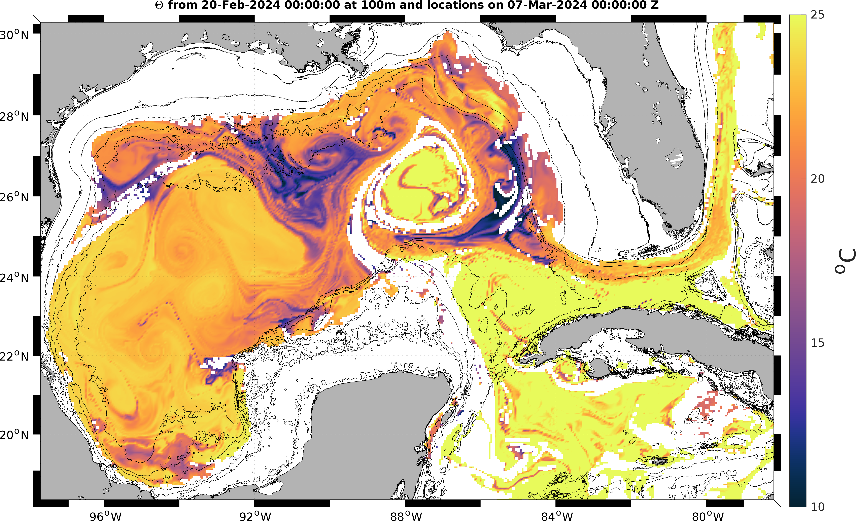
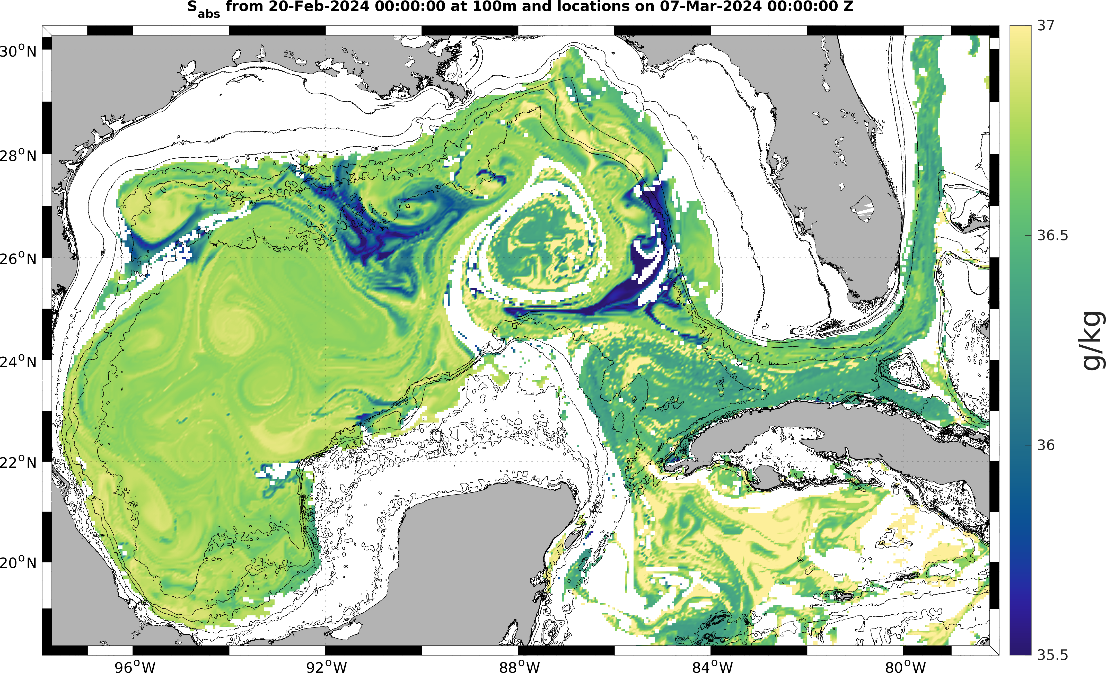
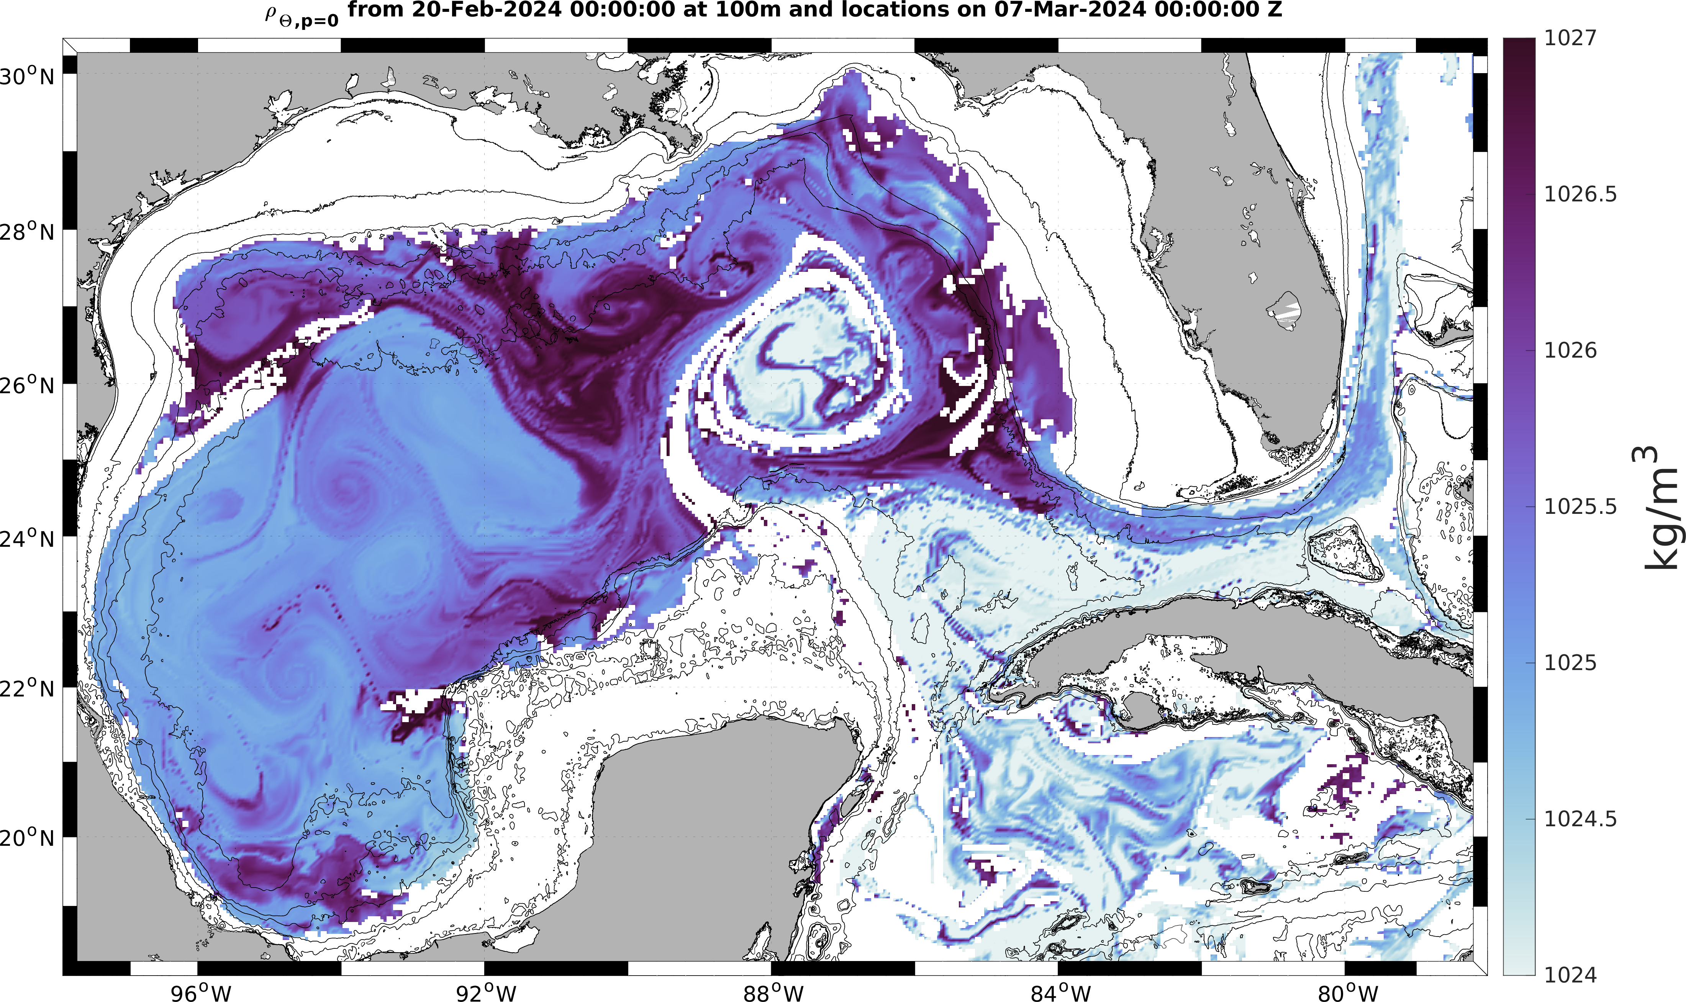
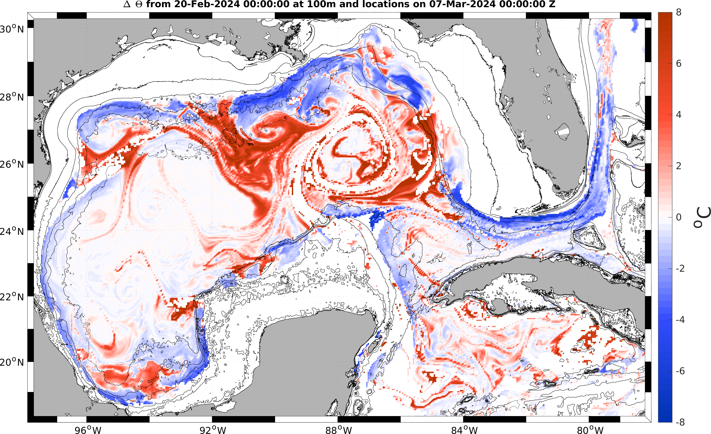
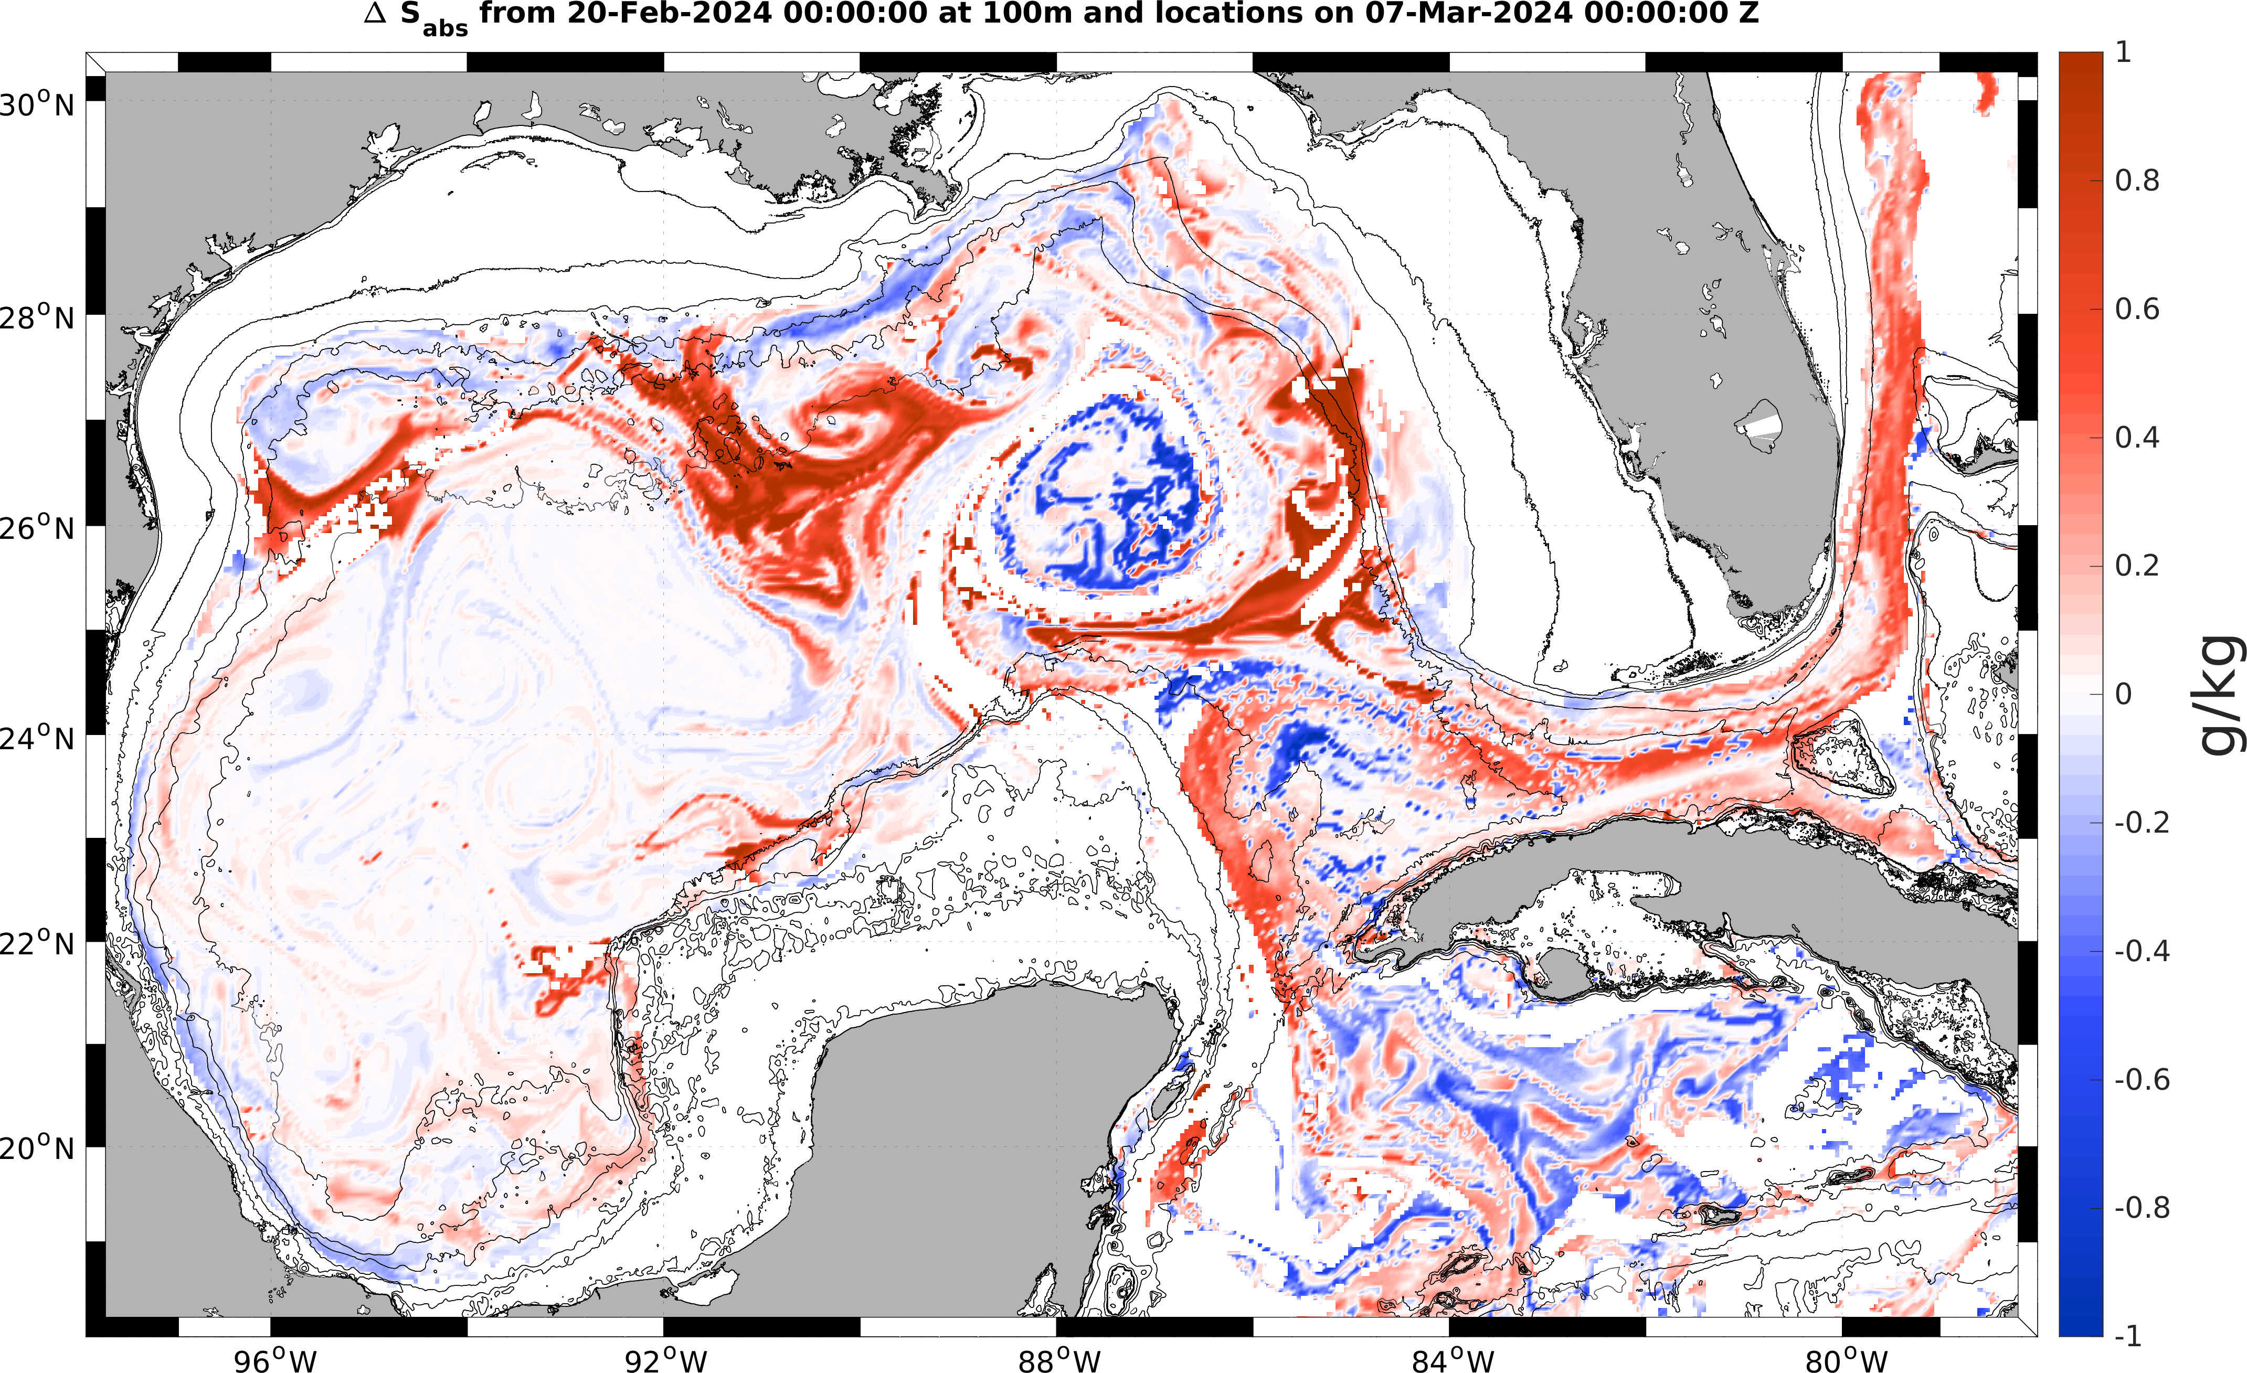
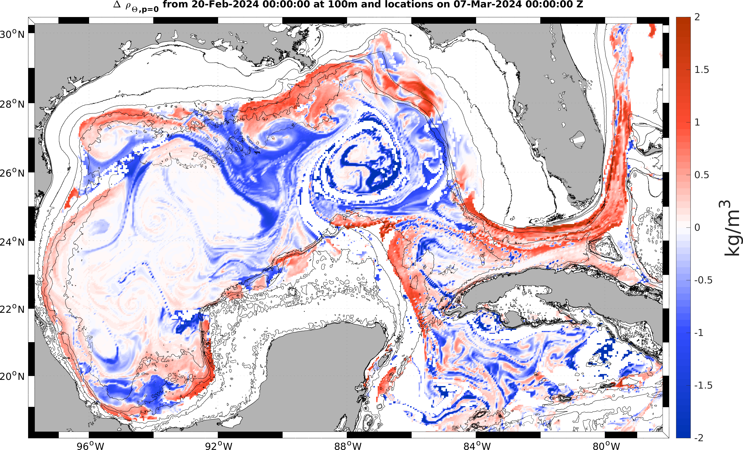
MSEAS-PE Evolution of Backward Flowmaps (100 m): Feb 20 – Mar 7, 2024 (Cont.)
Advected Temperature
Advected Salinity
Advected Potential Density
Initial values advected
at final positions
Full T – Advected T
Full S – Advected S
Full ρ_{θ} – Advected ρ_{θ}
Differences:
Full PE – advected fields
Nonzero differences show effects of non-advective processes

